Slide 1
蒙神祝福的開始
The Beginning of Blessings
詩篇Psalms 100:1-5

Slide 2
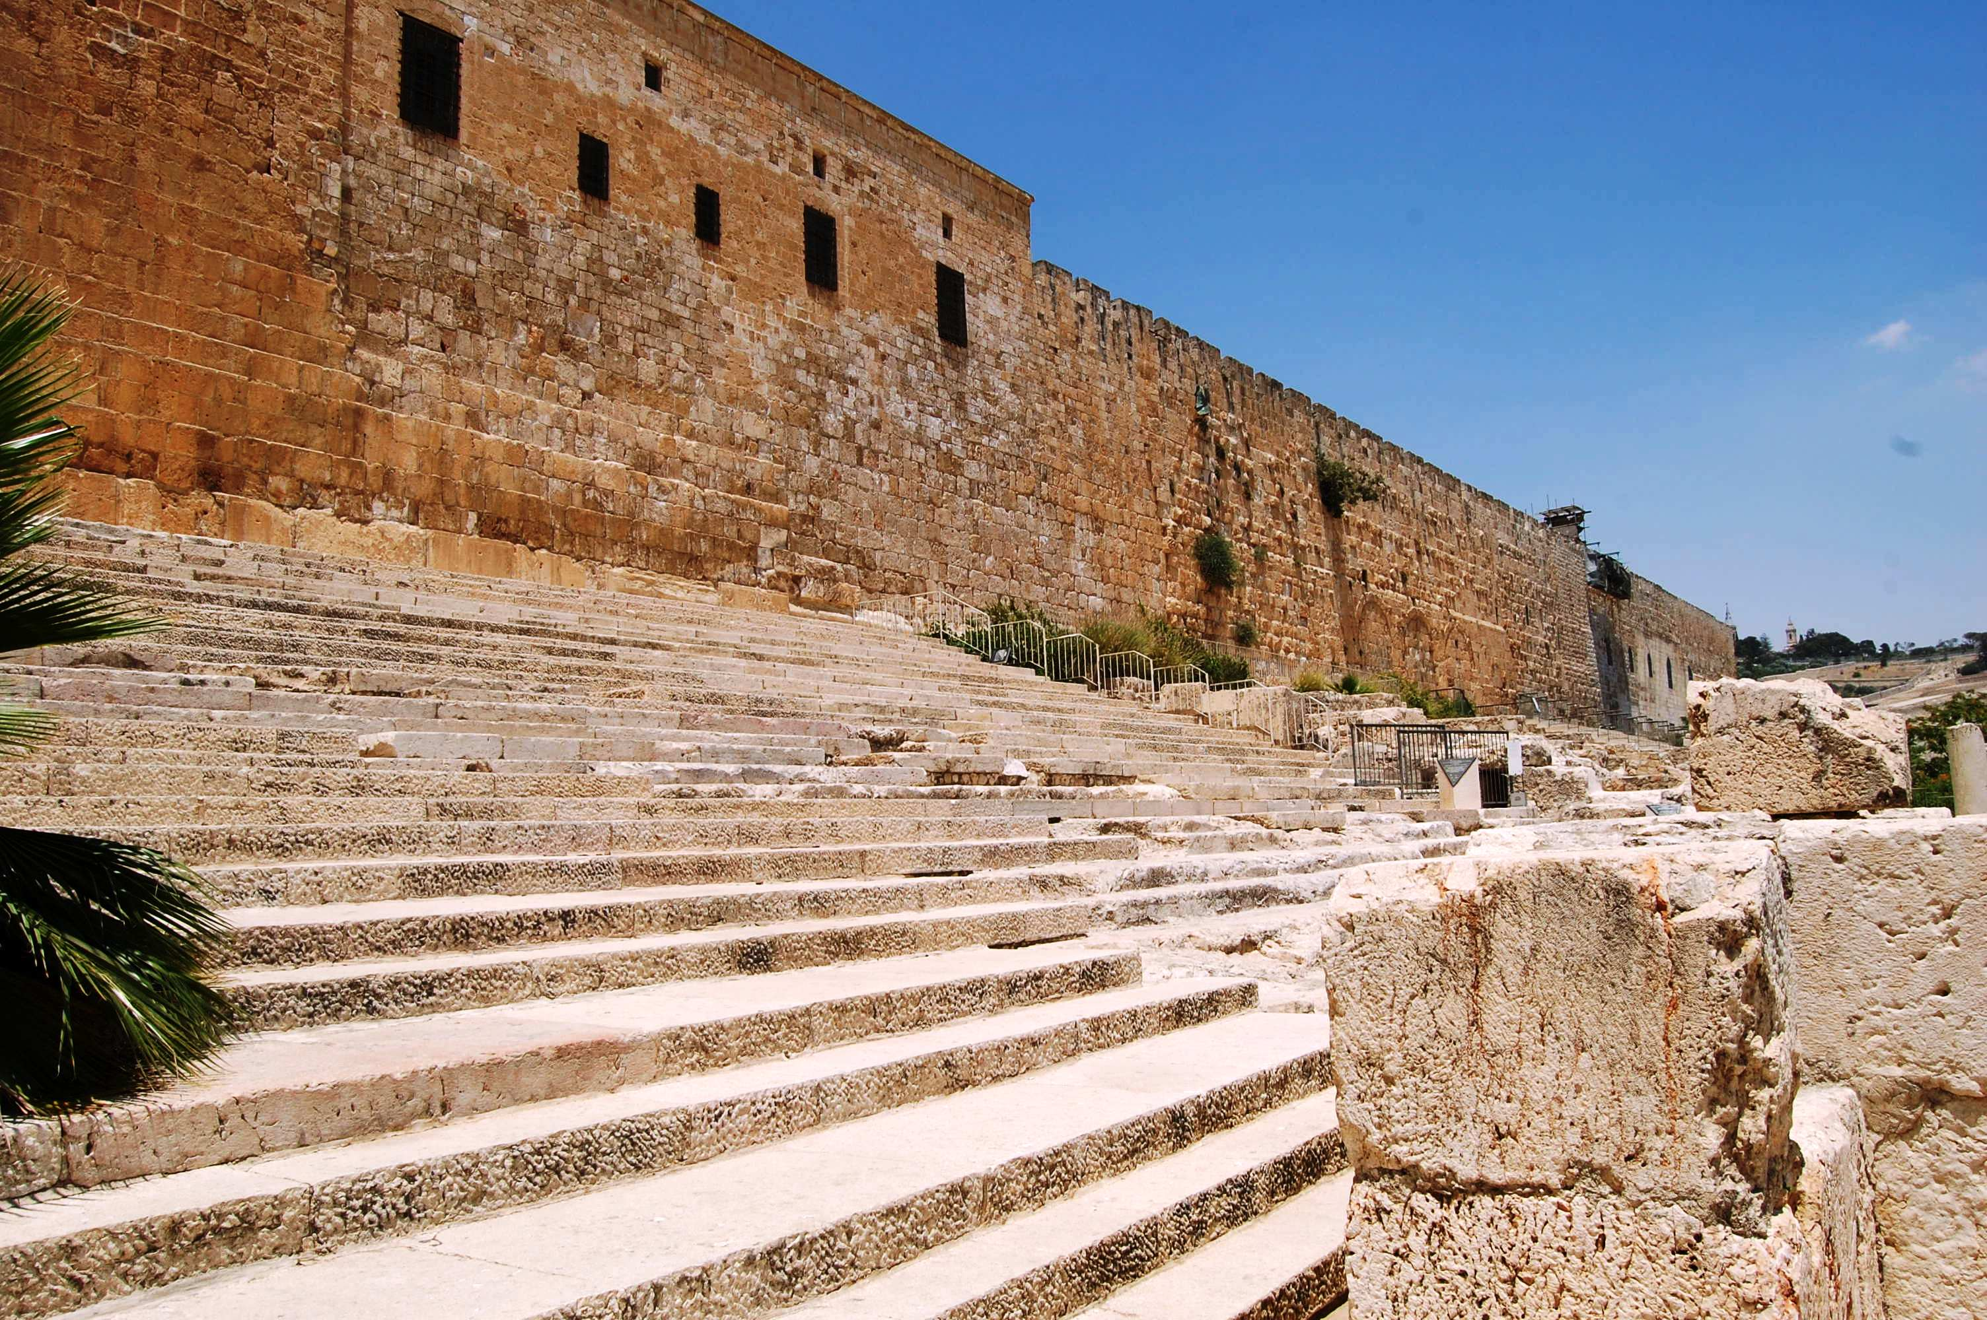
上行之詩
Psalms of Ascent

Slide 3
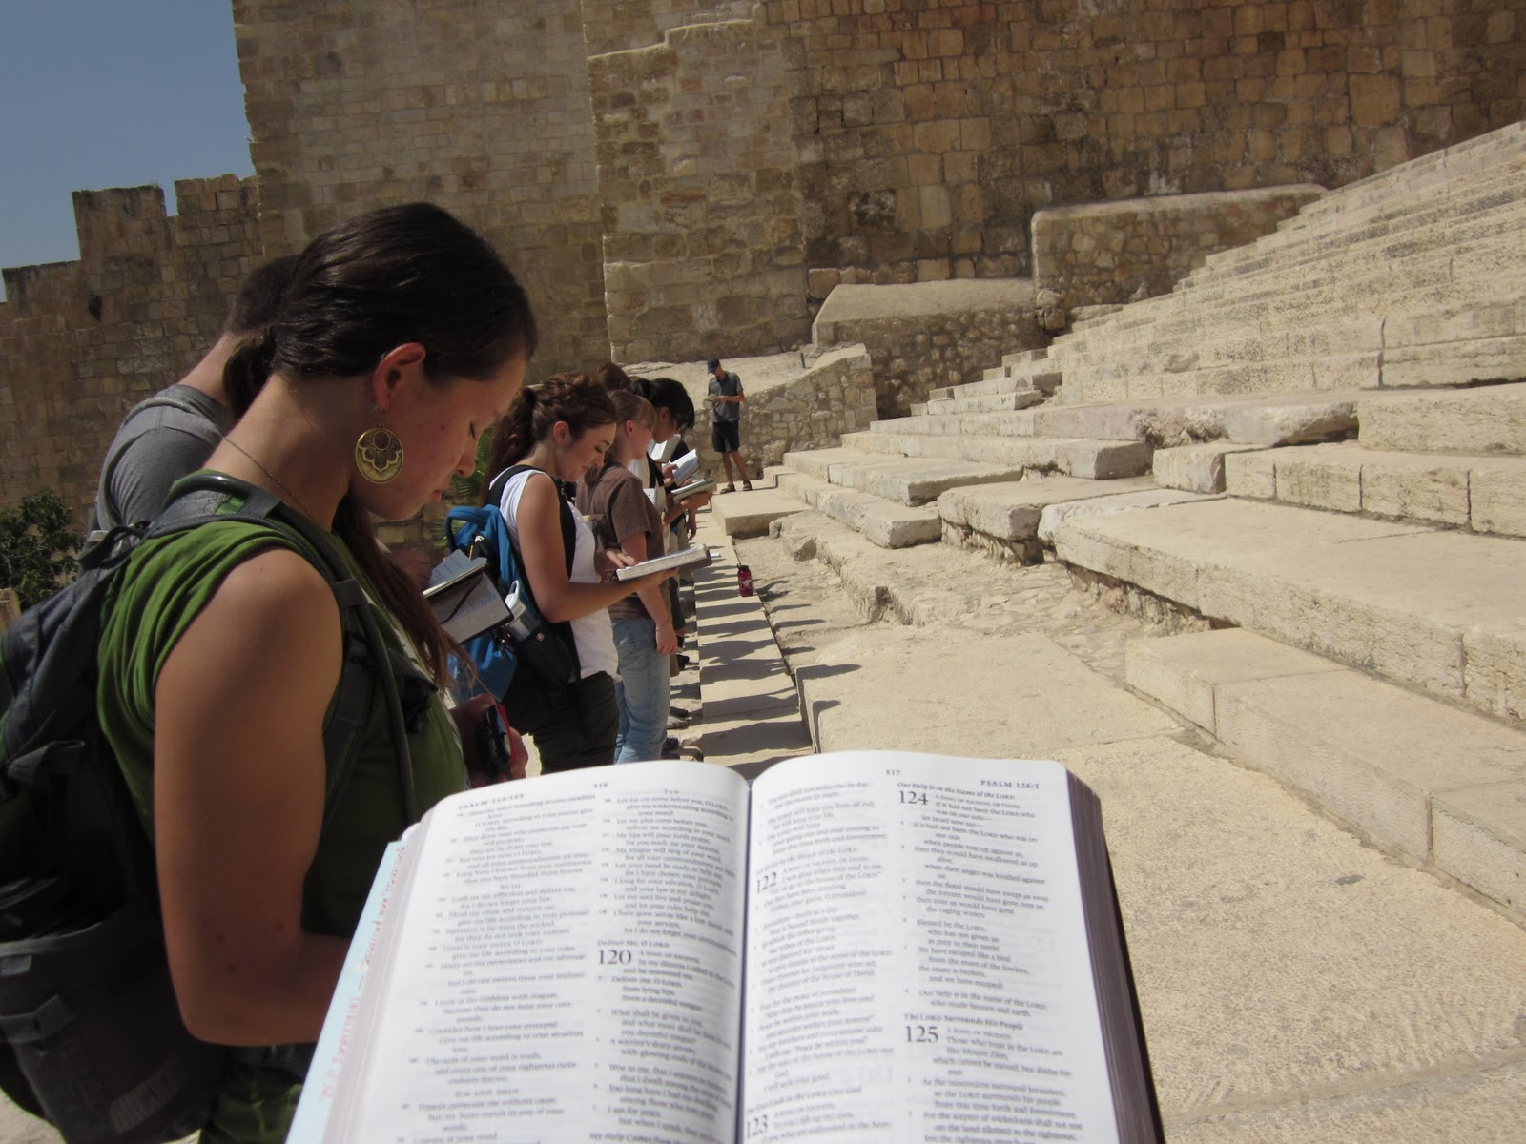

Slide 4
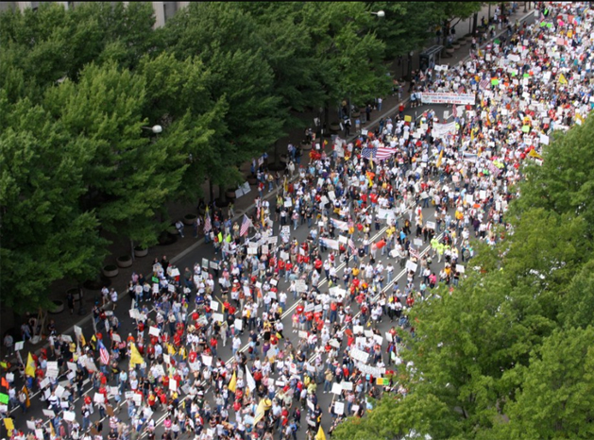
Million Man March: Stand in the Gap

Slide 5
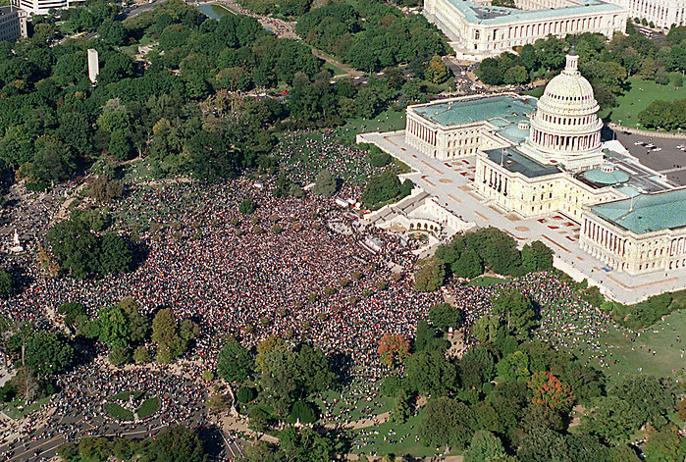

Slide 6
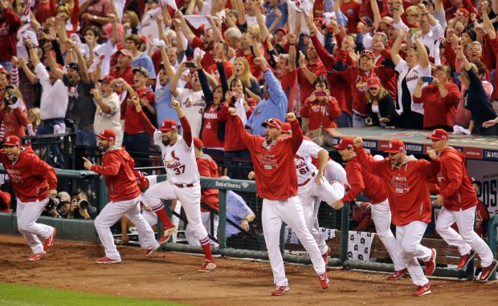
歡呼 raise-a-shout-you

Slide 7
B.事奉 serve-you
台東興昌基督長老教會

Slide 8
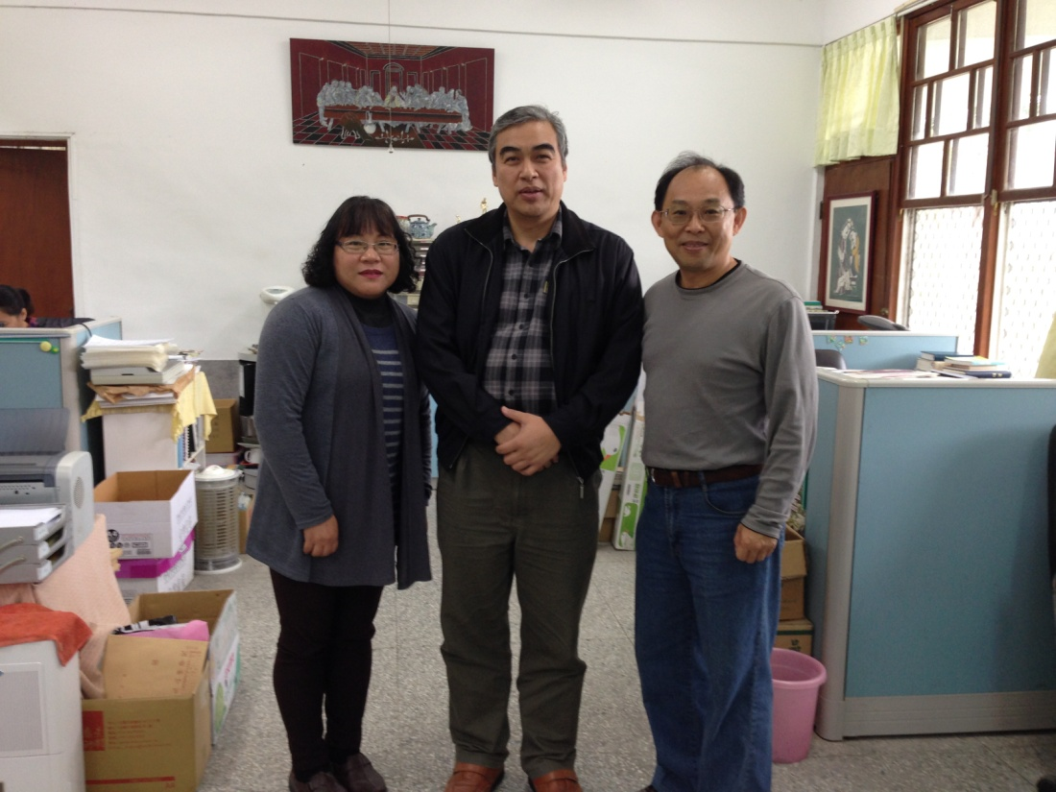
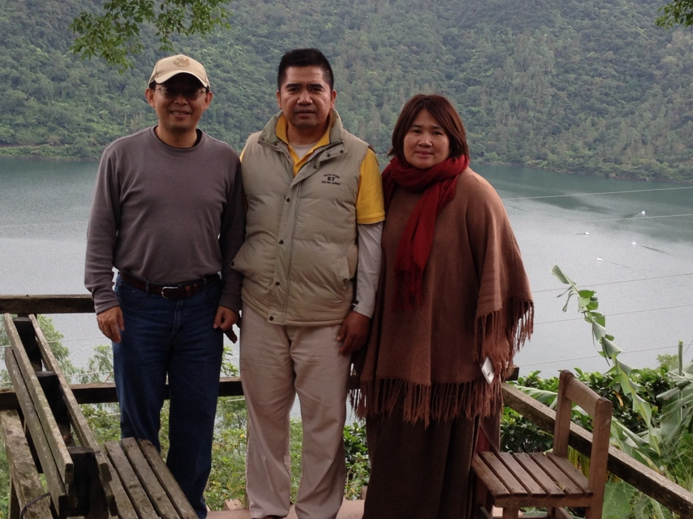
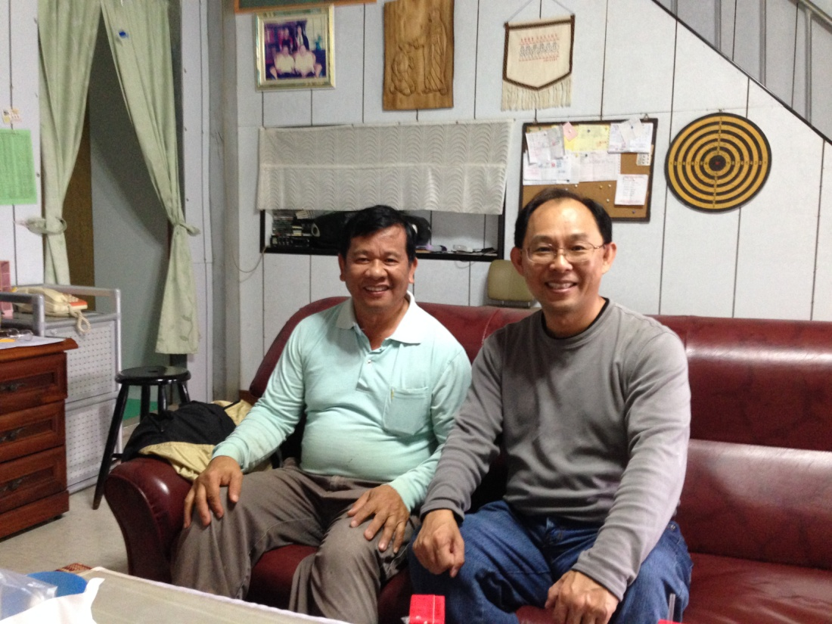
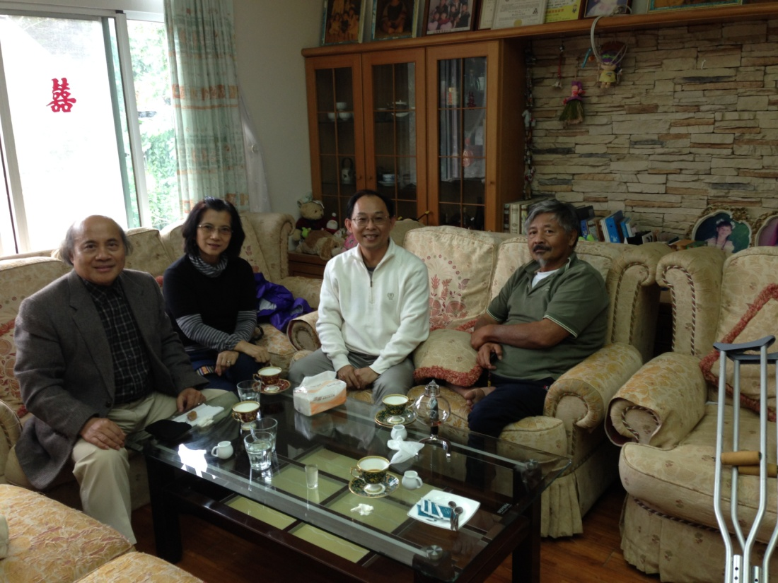
1
2
4
3

Slide 9
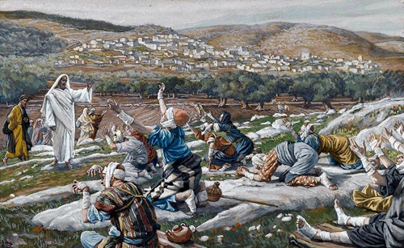
C. 來 Come-you

Slide 10
D. 認識Know-you
『我兒所羅門哪，你當認識耶和華你父的神，誠心樂意地事奉他…』（代上28：9）
⁹ “And you, my son Solomon, acknowledge the God of your father, and serve him with wholehearted devotion and with a willing mind...”(1 Chronicles 28:9)

Slide 11
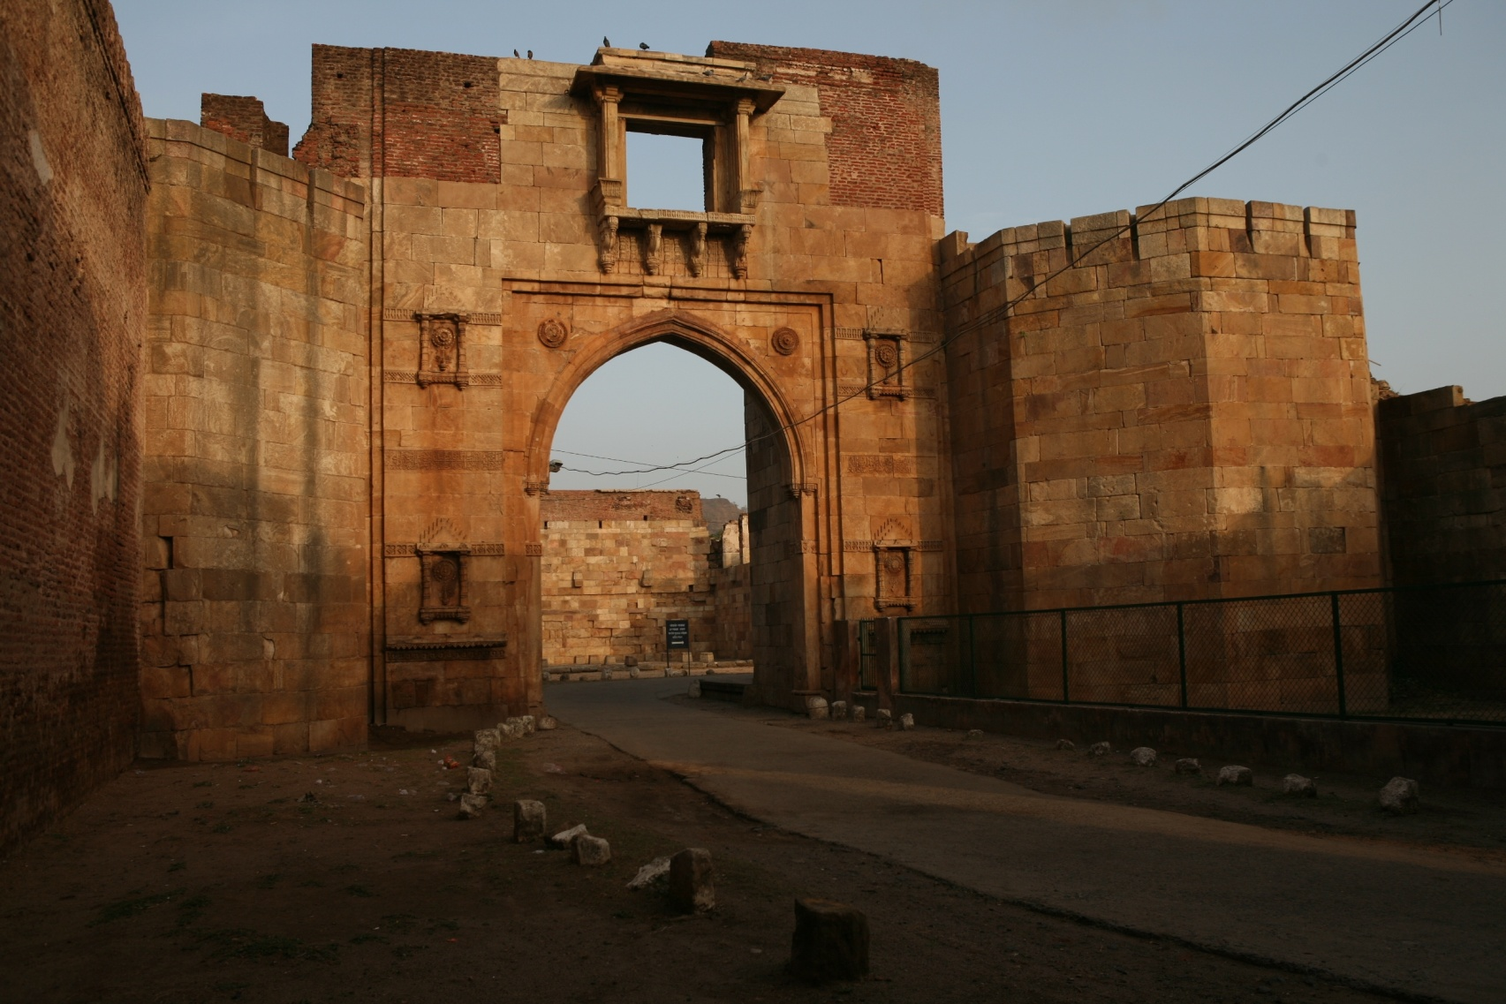
E. 進入Enter-you

Slide 12
F. 感謝 acclaim-you

Slide 13
G. 稱頌Bless-you
1.上帝本為善
God is good
2.祂的慈愛
kindness of him
3.祂的信實faithfulness of him

