Slide 1
Last week during the TPC retreat, every church had to prepare for a program.
One sister suggested that we sing a few hymns that were adopted from Taiwanese folk songs. Coincidentally, Elder Lin lent me a book titled “Chronicle of Formosa – Mackay’s Memoir in Taiwan.” I decided to combine the Taiwanese folk songs and the story of Mackay. I named the skit “The Love for Formosa Taiwan.” The plot was finished just a day before the retreat. We started rehearsal on Friday night at 9:30pm. The skit was presented Saturday at 4pm. Let us welcome the stars in the skit “The Love for Formosa Taiwan.”

Slide 2
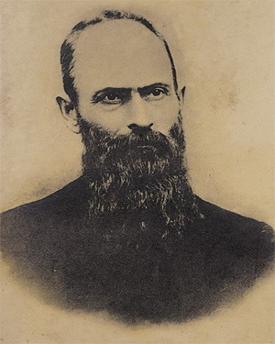
福爾摩沙
台灣情
馬偕：寧願燒盡，不願鏽壞
柑縣教會熱情演出

Slide 3
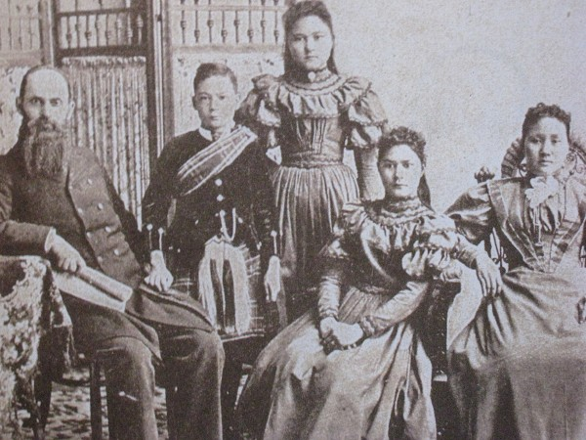

Slide 4
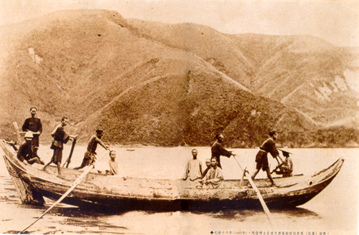

Slide 5
四季紅
春天花吐清香，
鳥隻唱歌出大聲，
蝴蝶飛來且飛去，感謝主聖名 趕緊來，緊來就近主
出聲吟讚美主，吟詩唱歌讚美主
1/4

Slide 6
2/4
夏天風正輕鬆，
雙人坐船在遊江，
看見美麗好風景，咱攏著感謝
趕緊來，緊來就近主，
出聲吟讚美主，吟詩唱歌讚美主

Slide 7
3/4
秋天月思故鄉，
大家同心來祈禱，
台灣是咱主所疼，各項遵主命 趕緊來，緊來就近主
出聲吟讚美主，吟詩唱歌讚美主

Slide 8
4/4
從東西通南北，
傳主奇妙的福音，
天邊海角各時代，主疼永不廢 趕緊來，緊來就近主
出聲吟讚美主，吟詩唱歌讚美主

Slide 9
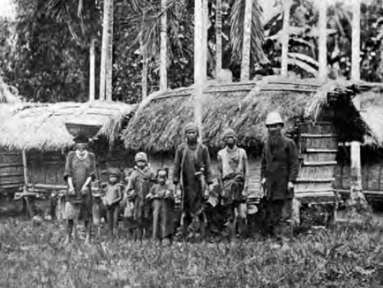

Slide 10
使命（青蚵仔嫂歌調）
奉差傳報拯救福音，
受抓釋放黑暗光明，
上帝真理公義自由，
不變準繩世人遵行。
1/2

Slide 11
2/2
宣揚服務安慰教督，
勇敢拔出拆毀傾倒，
信心希望建立栽培，
完成先知時代使命。

Slide 12
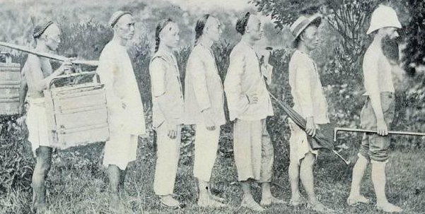
挑夫
嚮導
柯玖
莊天能
順仔
阿華
馬偕

Slide 13
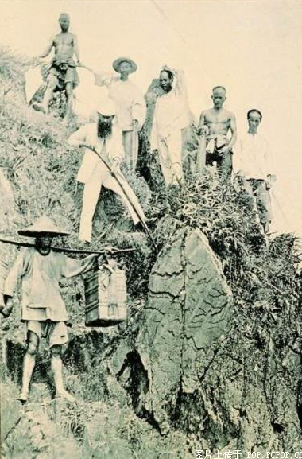

Slide 14
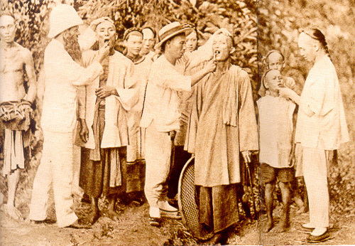

Slide 15
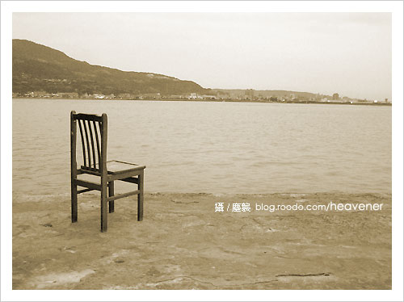
望你早歸
1.每日思念你一人
我骨肉之親
懇求聖神進入你的心
感動你來信靠主
2.耶穌以外無別路
祂是救世主
怎樣你那硬心全然不信
棄揀祂拒絕真理

Slide 16
（副歌）若是想看末日
主再來的時
加添阮心內悲哀
彼時主若分綿羊山羊
也是咱拆分離之時
3.阮只好來拜託聖神
替阮講給他知
講阮每日悲傷流目屎
希望你早一日悔改

Slide 17
最後一堂課

Slide 18
一粒麥子的服事
The service of a kernel of wheat

Slide 19
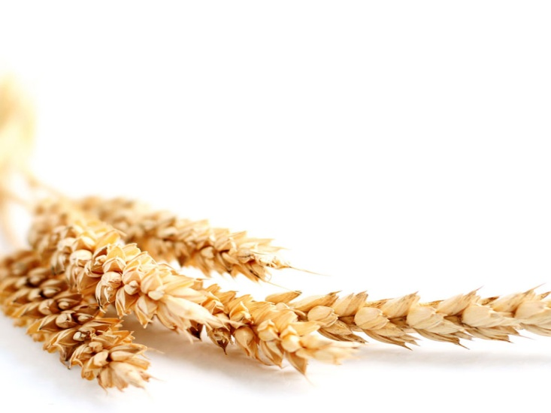
Gospel of John, Chapter 12 recorded the last public itinerary of Jesus’ journey, including Jesus entering Jerusalem on a young donkey and some Greeks coming
to visit Jesus. A keen reader may notice that two forces were emerging. On one hand, it was obvious that Jesus was welcomed and supported by crowd. When Jesus was entering Jerusalem, Disciples witnessed the people waving the palm branches and saying “Hosanna! Blessed is he who comes in the name of the Lord!” (John 12:13). People also spread out the incident when Jesus brought Lazarus back from death. Even the Greeks asked to see Jesus.

Slide 20
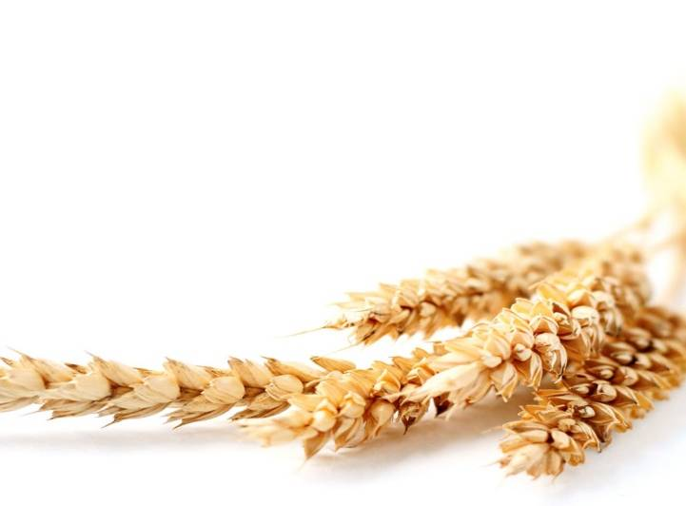
On the other hand, we also see that the Jewish
religious leaders enforced their ideation to get rid of Jesus. The religious leaders were uneasy about how powerful Jesus’ influence has become. “So the
Pharisees saidto one another, “See, this is getting usnowhere. Look how the whole world has gone after him!” (John 12:19) At the breaking point of these
two forces, some Greek appeared in the verses. Theyasked to be seen by Jesus. They are Greek, not
Jewish who speak Greek.They were Greek who
converted to Judaism. They were the “God-fearing gentiles”.

Slide 21
These Greek did not go to Jesus directly. Instead,
they went to Jesus’ disciple, Philip. The Bible did not explain why they went to Philip. It may be because
Philip was a Greek name. It may also be because
Philip spoke better Greek among the disciples.
Some Bible scholar also thought that Philip was the
somewhat slower one because he was the last to
recognize Jesus after the resurrection. Regardless thereason, the seeking of Greek pushed Jesus to the
apex. Jesus stated “The hour has come for the
Son of Man to be glorified.” (John 12:23)

Slide 22
Before Chapter 12, Gospel of John recorded that Jesus’s hour “has not yet to come.” (John 2:3, 4:21, 4:23, 8:20). Hence, Jesus’ action has beenrather low-key and reserved.
The Greek’ seeking was a turning point of Jesus’ servie. Jesus predicted that He will die and
resurrect. He also announced that the “moment
of glory” has come. Jesus used a kernel of wheat to explain his ministry and service.

Slide 23
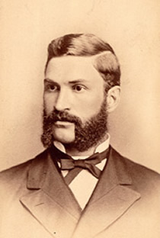
[Testimony]
George Leslie Mackay was
born in Zorra, Ontario, Canada.
His parents Were immigrants
from Scotland. He was the first
Generation Scottish Canadian.
In his youth the thought of being a missionary first came to Mackay. To fulfill his plan, Mackay went to Toronto to attend Knox College and a further three years at Princeton Seminary in New Jersey, USA. Then Mackey went to the Scotland to be trained.

Slide 24
Before departing for Scotland, Mackey had applied to the Presbyterian Mission Board in Canada. The prospects were not encouraging. In its 16 years existence, the Board had not sent even one missionary abroad. While in Scotland Mackey was pleasantly surprised when he was accepted by the Canadian Board as a missionary to China. He return immediately to Canada with a burning desire to preach the gospel in Asia. He was the first foreign missionary by the Canada
Presbyterian Church.

Slide 25
Mackay’s strength for service came from his deep-rooted faith and full reliance on God. He first
experienced tremendous loneliness and anxiety when
Mackay was traveling from San Francisco to Asia. He
thought about leaving his family and friend and going to a country predominately believes a different religion.
He also wondered if he would encounter any violent
tribe or terrifying situations. Would he ever have the
Opportunity o return to his home? Whether he made the
Wrong decision? Drifting in the endless ocean, God’s
Words strengthened his faith. Dear brothers and sister,
anybody may encounter moment like that, even thought
The Lord Jesus experienced the same struggle and
trial in The Garden of Gethsemane.

Slide 26
Mackay was originally commissioned by the
Presbyterian Church of Great Britian. He was asked to
choose between Xiamen, Shantou, or Taiwan. However, it seems like an invisible force was pulling Mackay to
Formosa Taiwan, the beautiful island. Mackay first
arrived at Takao (Kaohsiung), he then visited Rev.
Hugh Rithie in Pingtung to learn Taiwanese. Missionary told Mackay that there was not any missionary in the
northern region. Therefore, Mackay and Rev. Ritchie
travel by boat to Tamshui on March 9. When Mackay first went ashore and checked out the surrounding hills. He
then heard a voice saying “Here is the land.”
He prayed “Lord, this is the place. Please help me to
glorify you until my death.”

Slide 27
Mackay was in northern Taiwan for a 29 year mission. His mission method was simply
“keep traveling.” To be more specific, whenever he
arrived at a new place, he have free physical
checkup and give medicines. The second time he
visited the place, he started spreading the gospel.
The third time he visited, he training new believers
and searched for a place for worship. The fourth
time, he assign co-workers to continue to work
at the local church. He was able to be recognized
And accepted by the local Taiwanese. Mackay took
off hisshoes and walked over the island. North to
Keelong,East to Su-Ao
and Kavalan (Yilan).

Slide 28
He also spread gospel to the Pingpu natives and south
to Miaoli. He established over 60 churches. Ordained
two pastors and equipped 60 ministers. Mackay also
established over 60 clinics and extracted over 21000
teeth. Other than churches, he also founded Oxford
College and Tamshui Women’s School. Mackay often
Traveled with students and taught lessons by the street or creek, under a tree or in a theater, or simply wherever they went. Mackey was not only the cradle of modern
Education in northern Taiwan, his contribution included western medicines, modern science, agricultural
techniques and products, and public health. Mackey always willing to learn all kinds of skills and techniques.
He was also obedient to the guidance of the Holy Spirit,
tried different ways to spread the gospel. Mackay’s
creativity and courage was sure a great example to us.

Slide 29
Conclusion:
Dear brothers and sisters, 150 years ago, missionaries from England and Canada followed Jesus’ teaching and allowed themselves to be kernels of wheat that
fell in the Taiwanese soil. Our ancestors heard
gospel from these missionaries and led us into the
faith. We all bear fruits to these missionaries’ effort and sacrifice. As what Jesus said, “Very truly I tell you, unless a kernel of wheat falls to the ground and dies, it remains only a single seed.” (John 12:24).

Slide 30
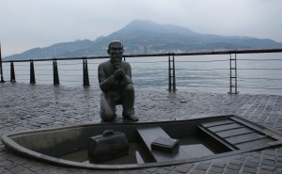
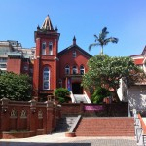
Year of 2015 will be the 150th anniversary of the
establishment of The Presbyterian Church in Taiwan. There will have a series of celebration.
Southern California TPC also prepare to attend the
Celebration and mission in Taiwan. You may start saving up $200 per month for this meaningful trip next year.

Slide 31
Mackay has a “true Taiwanese spirit.” He loves
Taiwan more than many Taiwanese.
He once confessed that “O Formosa, so far away
and so beautiful. You are the love of my life. I love
you all, each and every one of you, regardless of
your origin and the past. To serve you with the only Good News I know. Here is my life for you, a
thousand times and more…”

Slide 32
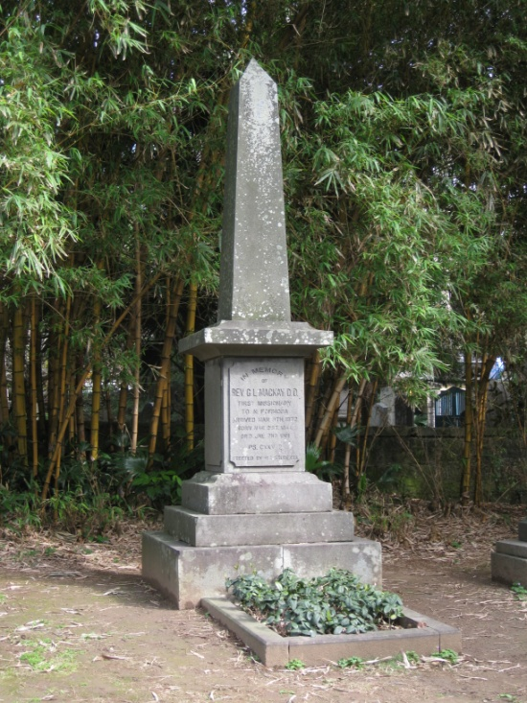
Indeed, Mackay not only spent his best years in Taiwan, he also married Tiu Chang-Mia, a Taiwanese lady.
Mackay eventually died in Taiwan and buried in TamshuiWe may fully understand this passage of John 12:24
when we look at Mackay’s life. More importantly,
we need to be a grateful Christian. Through community service, Prayer and care, we need to
pass on the faith. Because of your
service and sacrifice, gospel will be
spread even further. At last, let us
listen to the song “Find a final
resting place.” The final resting
place that Mackay longed for was
Formosa, our hometown Taiwan.

Slide 33
Find a final resting place (Mackay’s Original Poem)
How dear is Formosa to my heart! On that island
the best of my years have been spent. How dear is
Formosa to my heart! A lifetime of joy is centered
here.I love to look up to its lofty peaks, down into its yawning chasms, and away out on its surging
seas. How willing I am to gaze upon these forever! My heart's ties to Taiwan cannot be severed! To
that island I devote my life. My heart's ties to
Taiwan cannot be severed! There I find my joy. I
should like to find a final resting place within soundof its surf, and under the shade of its waving
bamboo."

Slide 34
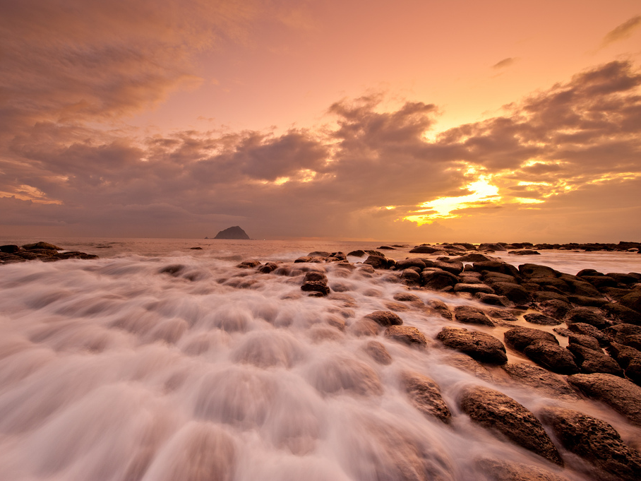
最後的住家（馬偕的詩，鄭智仁作曲）
我全心所疼惜的台灣啊!
我的青春攏總獻給你。
我全心所疼惜的台灣啊!
我一生的歡喜攏在此。

Slide 35
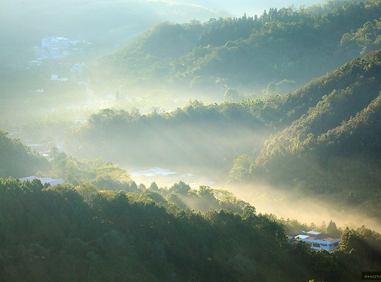
我在雲霧中看見山嶺，
從雲中隙孔觀望全地，
波瀾大海遙遠的對岸，
我意愛在此眺望無息。

Slide 36
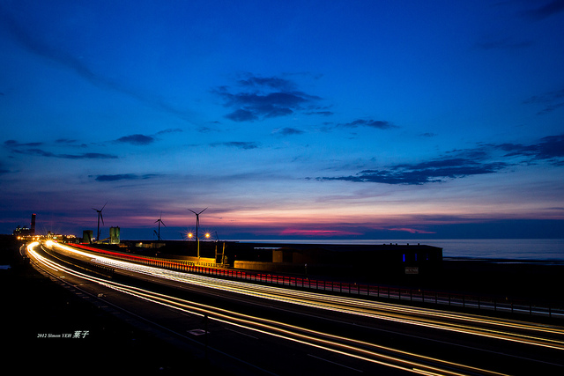
我心未可割離的台灣啊!
我的人生攏總獻給你。
我心未可割離的台灣啊!
我一生的快樂攏在此。

Slide 37
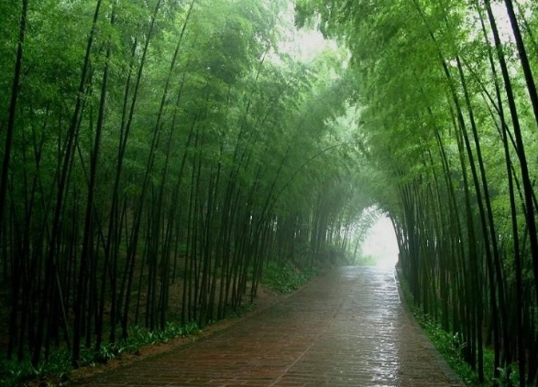
盼望我人生的續尾站，
在大湧拍岸的響聲中，
在竹林搖動的蔭影裡，
找到一生最後的住家。

