Slide 1
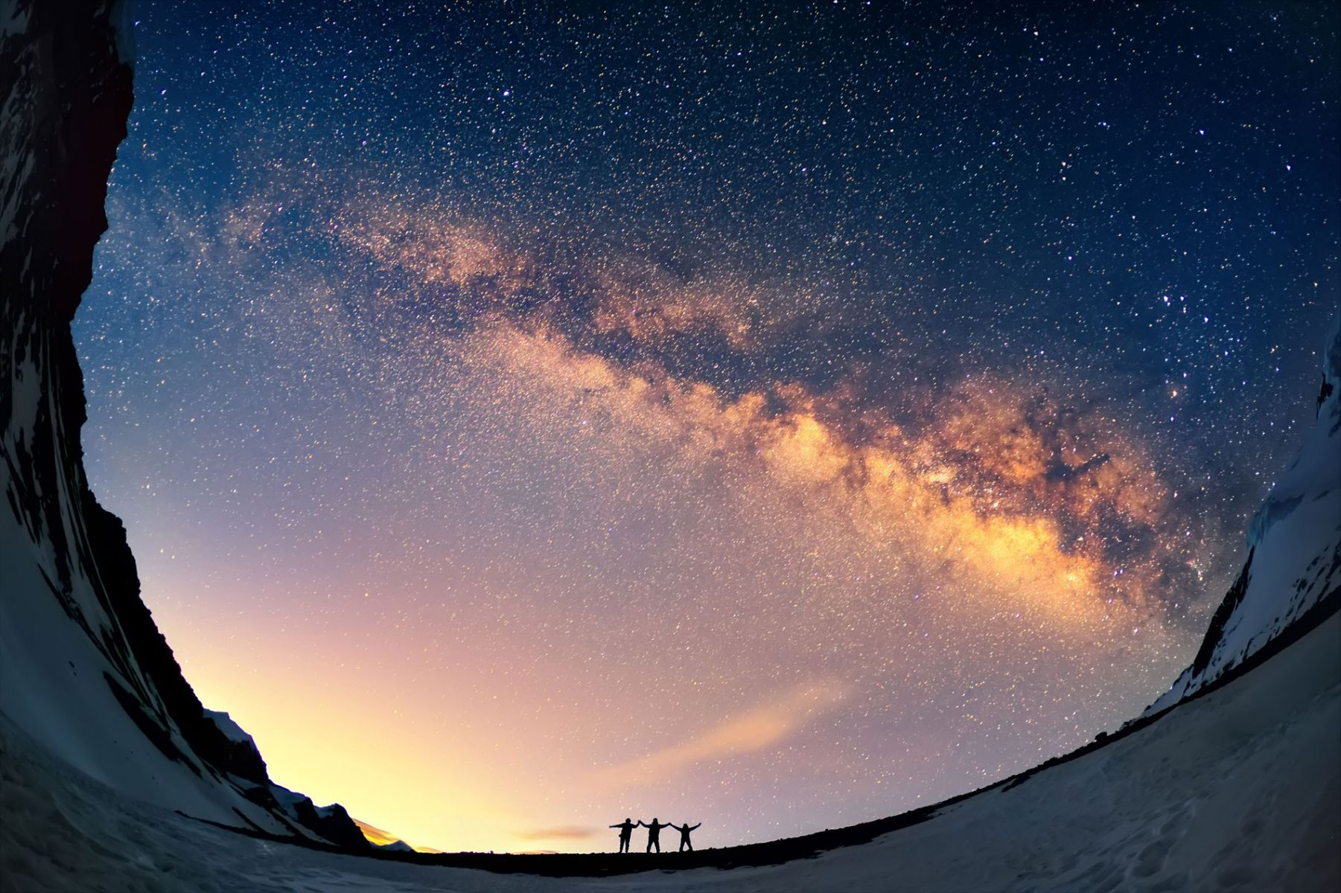
咱會改變此世界
We can make a difference
聖歌隊 獻詩
咱會改變此世界
We can make a difference

Slide 2
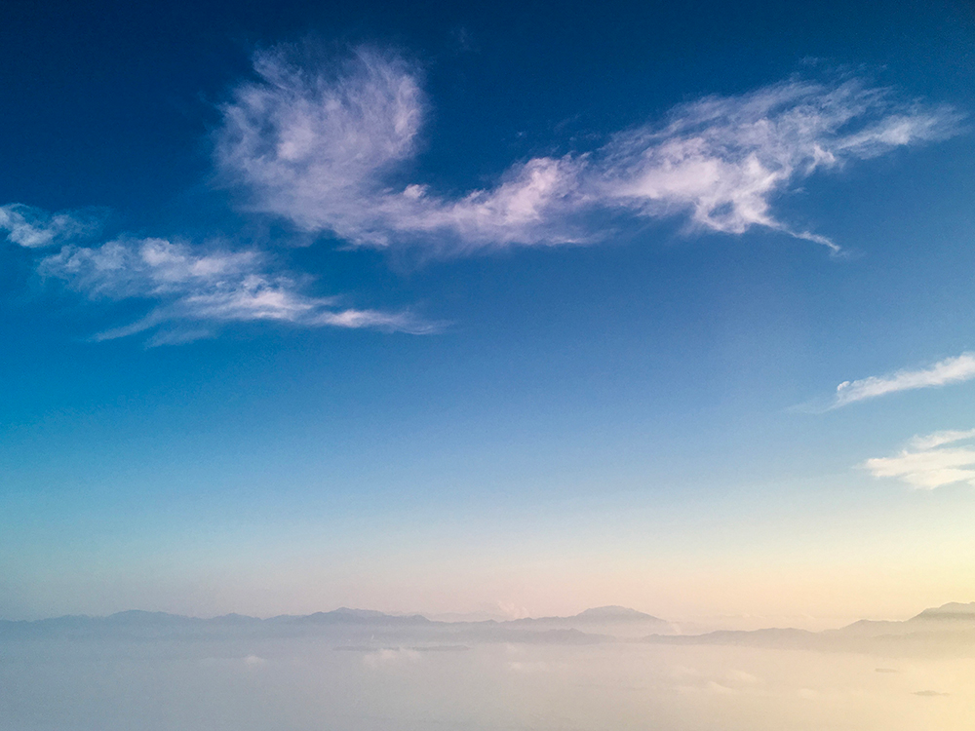
咱在此，在這新日子之清早。
Here we are, at the dawning of a new day.
一切前途隨時會屬咱
Soon all of the future will be ours
咱若時常追求永遠屬天福氣
And we can do our part to make a better world
咱就能盡本份使世界較美!
If we always keep on reaching for the stars
咱會改變此世界
We can make a difference

Slide 3
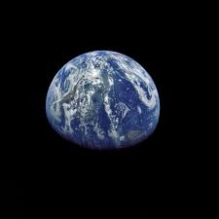
若盡力 你我能改變此世界
If we try, you and I can make a difference
若盡力 咱就能實現美夢
If we try, we can make our dreams come true.

Slide 4
到彼日咱會看見充滿
和諧平安之世界
And one day, we can live to see a world of peace and harmony
咱若盡力能改變此世界
Yes, we can make a difference, if we try

Slide 5
相同行 咱可學習相與做工
Side by side, we can learn to work together
相牽手 可使人生較美好。
Hand in hand, we can build a better day.
無論前途怎樣，是你我來保守
For what the future brings, is up to you and me
所以咱當盡一切氣力做工
So let’s do our very best a long the way

Slide 6
若盡力咱能改變此世界
If we try, we can make a difference
若盡力 咱就能實現美夢
If we try, we can make our dreams come true.
到彼日咱會看見充滿和諧平安之世界
And one day, we can live to see a world of peace and harmony

Slide 7
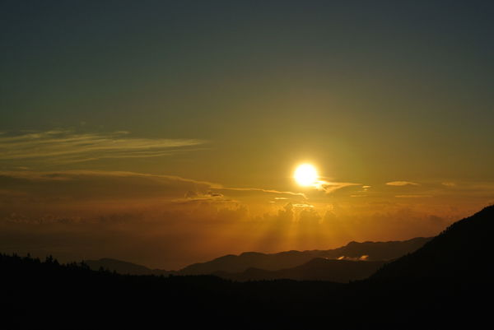
若盡力 咱能改變此世界
If we try, we can make a difference
咱能改變此世界 若盡力
Yes, we can make a difference, you and me

