Slide 1

Take These Wings
送你一對翅股
聖歌隊Choir 獻詩

Slide 2
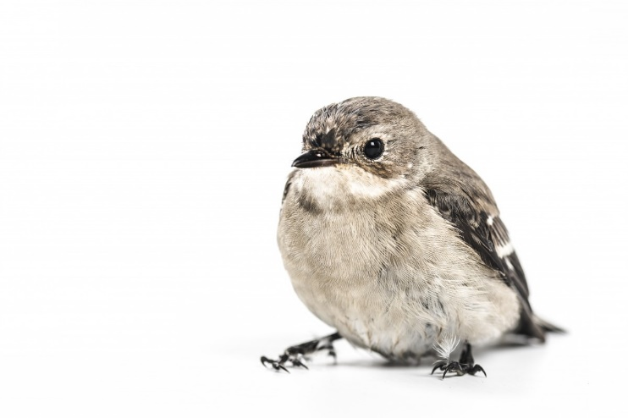
Take These Wings 送你一對翅股(V1-I)
I found a sparrow lying on the ground;
Her life I knew would soon be at an end.
I knelt before her as she made a sound,
and listened as she said ,”My friend,
我看著一隻雀鳥跌落地，
看伊的生命已經到路尾。
我跪落將伊托佇手心中，
伊輕聲對我講：朋友，

Slide 3
Take These Wings 送你一對翅股(V1-II)
Take these wings and learn to fly
to the highest mountain in the sky;
Take these eyes and learn to see
all the things so dear to me.
送給你 送給你這對翅股，
學習飛過高高的山谷。
送給你 送給你這對目睭，
學習看世上好事，

Slide 4
Take These Wings 送你一對翅股(V1-III)
Take this song and learn to sing,
fill your voice with all the joys of spring;
Take this heart and set it free,
Let it fly beyond the sea.
送給你喜樂詩歌，
讚美上帝創造的偉大 ，
送給你躍跳的心、
會感謝、會感謝、會感謝上帝恩惠。

Slide 5
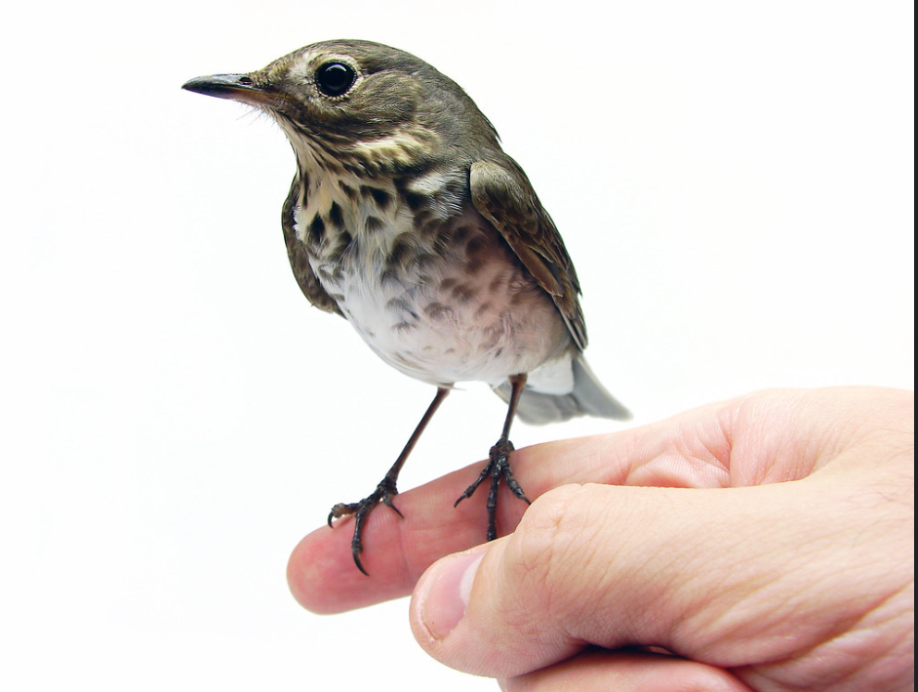
Take These Wings 送你一對翅股(V2-I)
I found another sparrow lying on the sand,
A tiny bird whose life had just begun.
I picked him and held him in my hand
I smiled at him and said, "My son.
我又看一隻雀鳥佇沙埔，
細細的生命開始要起步，
我輕輕將伊托佇手心中，
我笑笑對伊講：細囝，

Slide 6
Take These Wings 送你一對翅股(V2-II)
Take these wings and learn to fly
to the highest mountain in the sky;
Take these eyes and learn to see
all the things so dear to me.
送給你 送給你這對翅股，
學習飛過高高的山谷。
送給你這對目睭，
學習看世上好事，

Slide 7
Take These Wings 送你一對翅股(V2-III)
Take this song and learn to sing,
fill your voice with all the joys of spring;
Take this heart and set it free,
Let it fly beyond the sea.
送給你喜樂詩歌，
讚美上帝創造的偉大 ，
送給你躍跳的心、
會感謝、會感謝、會感謝上帝恩惠。

