Slide 1

Hear the Good News
當聽好的消息

Slide 2

Narrator: “And there were shepherds living out in the fields nearby. An angel of the Lord appeared to them, and the glory of the Lord shone around them, they became terrified.
彼那方有顧羊者住佇曠野，暝時守更顧他們之羊群，主的天使倚近他們之身邊，主之榮光圍櫐照他們，顧羊者真驚惶。

Slide 3
And the angel said. “ Do not be afraid; I bring you good news of great joy that will be for all the people. Today in the city of David a Savior has been born for you. He is Christ the Lord.”
天使對他們說“不免驚，我報恁
大歡喜的好消息互百姓攏有份，
因為今仔日佇大衛的城裏為
恁生一個拯救的，就是主基督.” 、

Slide 4

Hear the good news, hear what the angels say.
Hear the good news , the news of Christmas day.
請恁來聽，天使的好消息，
請恁來聽，聖誕的好消息

Slide 5

Hear the good news,
hear what the angels say.
Hear the good news of
Christmas day.
請恁來聽，天使的好消息，
來 聽 聖 誕 的 好 消 息

Slide 6

“Glory to the God, glory to God,
Glory to God in the highest.
Peace and good will,
peace and good will”
Hear the good news of Christmas day.
榮光上帝，榮光上帝，
榮光歸至高的上帝
喜樂和平，喜樂和平，
來聽聖誕的好消息

Slide 7
Angels we have heard on high, Sweetly singing o’er the plains,
And the mountains in reply, Echo back their joyous strains.
阮 有 聽 天 使 歌 聲
甜 蜜 歌 聲 透 天 城
大 山 小 山 在 回 應
歡 喜 音 韻 應 無 停

Slide 8

Gloria in excelsis Deo!
Gloria in excelsis Deo!
大榮光歸至高主上帝!
大榮光歸至高主上帝!

Slide 9
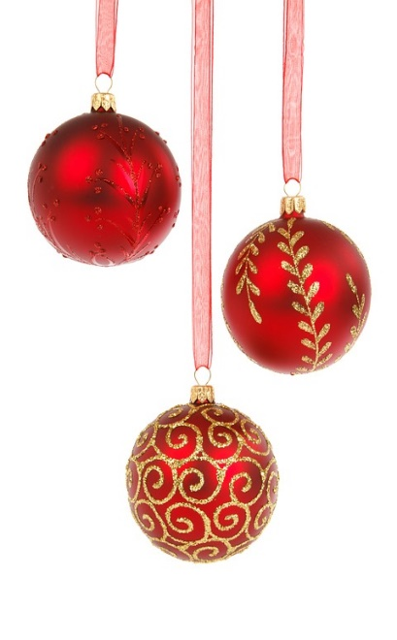
Hear the good news,
hear how the shepherds came.
Hear the good news, the news of
Christmas day. Hear the good news,
hear how the shepherds came.
Hear the good news of Christmas day.
請恁來聽，牧者也來跪拜，
請恁來聽，聖誕的好消息。
請恁來聽，牧者也來跪拜，
來聽聖誕的好消息。

Slide 10

Worship the Son, worship the Son, Worship the son of Jehovah.
Come and adore, come and adore;
Hear the good news of Christmas day.
朝拜聖子，朝拜聖子，
朝拜耶和華的聖子
來尊崇祂，來尊崇祂，
來聽聖誕的好消息

Slide 11
Shepherds, why this jubilee?
Why your joyous strains prolong?
Say what may the tidings be,
Which inspire your heavenly song?
何事牧者大歡喜
心神快樂很得意
你講這是啥道理
使你唱出天的詩

Slide 12
Gloria in excelsis Deo!
Gloria in excelsis Deo!
大榮光歸至高主上帝!
大榮光歸至高主上帝!

Slide 13
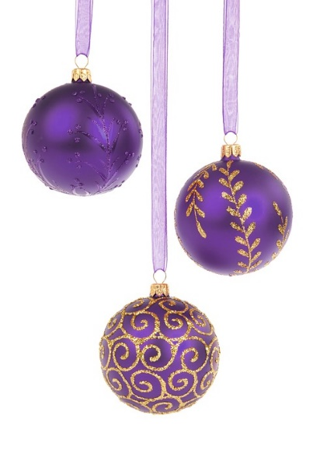
請恁來聽，博士也來朝拜，
請恁來聽，聖誕的好消息
請恁來聽，博士也來朝拜，
來聽聖誕的好消息
Hear the good news,
hear how the wise men came.
Hear the good news, the news of
Christmas day. Hear the good news;
hear how the wise men came.
Hear the good news of Christmas day.

Slide 14

朝拜聖子，朝拜聖子，
朝拜耶和華的聖子
來尊崇祂，來尊崇祂，
來聽聖誕的好消息
Worship the Son, worship the Son, Worship the son of Jehovah.
Come and adore, come and adore;
Hear the good news of Christmas day.

Slide 15
Come to Bethlehem and see
Him whose with the angels sing;
Come, adore on bended knee
Christ the lord the new born King.
請恁來到伯利恆
為祂出世天使吟
來朝拜於祂腳前
新王基督今降生

Slide 16
Gloria in excelsis Deo!
Gloria in excelsis Deo!
大榮光歸至高主上帝!
大榮光歸至高主上帝!

Slide 17
朝拜聖子，朝拜聖子，
朝拜耶和華的聖子
來尊崇祂，來尊崇祂，
來聽聖誕的好消息
Worship the Son, worship the Son, Worship the son of Jehovah.
Come and adore, come and adore;
Hear the good news of Christmas day.

Slide 18

Hear the good news of Christmas day.
Hear the good news of Christmas day.
Hear the good news of Christmas day.
來聽聖誕的好消息
來聽聖誕的好消息
來聽聖誕的好消息

Slide 19
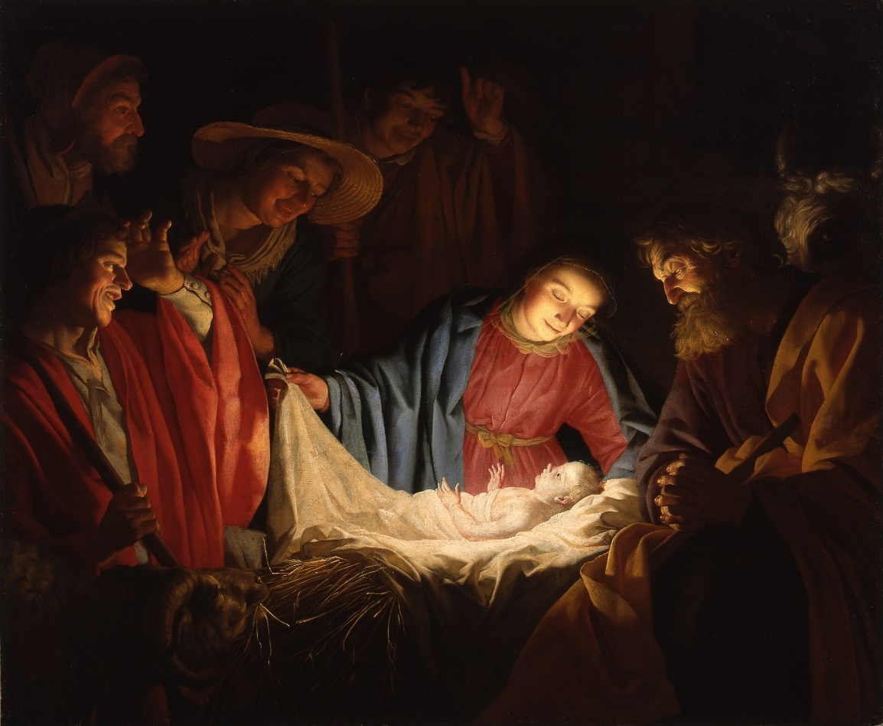
Child of Promise
應允的嬰兒

Slide 20
Narrator: “For unto us a child is born, unto us a son is giving; and the government shall be upon His shoulders and His name shall be called Wonderful Counselor, the mighty God, the everlasting father, The Prince of Peace.”
“因為有一個嬰仔為咱來出世，
祂欲負擔國政，祂的名欲稱做
奇妙謀士，全能的上帝，
永遠佇啲的父，和平的人君。”

Slide 21

Child of promise,
Lord of all,
quietly sleeping
on a bed of straw.
應允的嬰兒，
萬王之王，
祂安靜好睏在馬廄槽內

Slide 22
Angels in heaven rejoice
and give praise.
Sing, for the Savior
is born this day!
天頂天使歡喜出聲讚美。
吟詩，救主佇這日有出生！

Slide 23

For unto us
a Child is born,
Prince of peace
and Lord of lords.
為著咱一個囝仔誕生，
和平君王萬主之主。

Slide 24

On this night, a star burns bright,
shining the way
to the Truth and the Life,
shining the way
to the Truth and the Life!
佇這暗冥，一顆星燦爛發光，
為真理和活命開闢道路,
為真理和活命開闢道路.

Slide 25
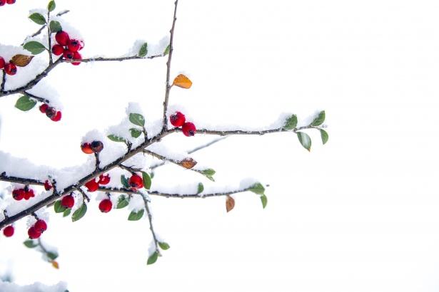
Child of wonder,
Hope of the earth,
shepherds and magi
celebrate Your birth.
奇蹟的囝仔，
世界的希望，
牧羊人和博士
慶祝祢的出生

Slide 26
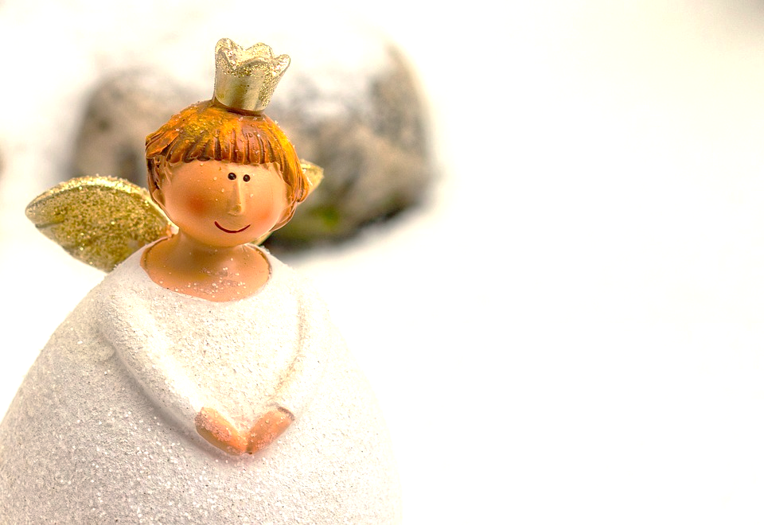
天使為祢出聲頌揚讚美！
祢帶來的恩典改變一切！
You are the reason the beautiful sing!
You bring the song
that will change everything!

Slide 27
For unto us
a Child is born,
Prince of peace
and Lord of lords.
為著咱一個囝仔誕生，
和平君王萬主之主。

Slide 28
On this night, a star burns bright,
shining the way
to the Truth and the Life,
shining the way
to the Truth and the Life!
佇這暗冥，一顆星燦爛發光，
為真理和活命開闢道路,
為真理和活命開闢道路.

Slide 29
For unto us
a Child is born,
Prince of peace
and Lord of lords.
為著咱一個囝仔誕生，
和平君王萬主之主。

Slide 30
On this night, a star burns bright,
shining the way
to the Truth and the Life,
shining the way
to the Truth and the Life!
佇這暗冥，一顆星燦爛發光，
為真理和活命開闢道路,
為真理和活命開闢道路.

Slide 31

Christ,
the Truth and the Life, The Life
基督，真理和活命，
活命

