Slide 1
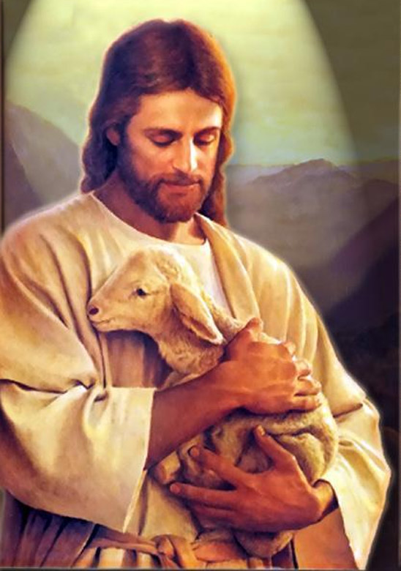
聖歌隊 獻詩
Sleep, Little Lamb
安静睡,羊羔
By Joseph Martin

Slide 2
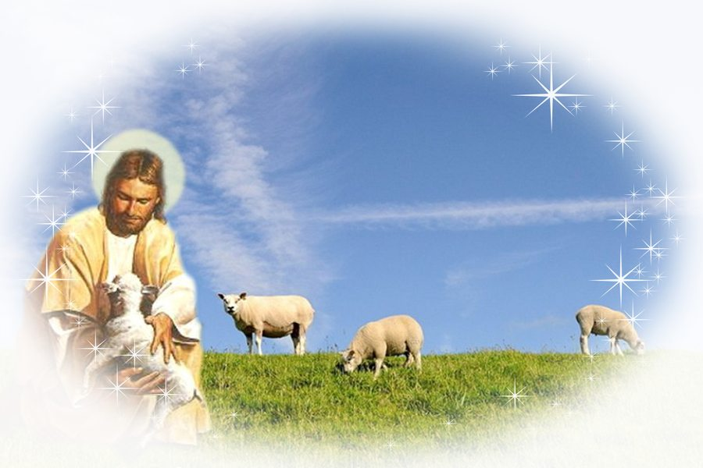
In the cold of winter, on the cloudless night,
Shepherds gazed upon Him in the pale moonlight;
佇寒冷之冬天，
無雲之暗暝，
在霧霧之月光暝，
牧者注神看祂。
1/8

Slide 3
Eyes so full of wonder, hearts so rich with joy, quietly they praised Him, the precious Baby Boy.
目睭充滿奇妙,
心歡喜趒跳,
怹對至寶聖嬰
輕聲讚美無停。
2/8

Slide 4
Quietly we praise You.
Gently we adore You.
Tenderly we lift our songs to the newborn King.
阮輕聲讚美祢,
阮謙遜尊崇祢。
阮溫柔出聲唱歌
獻給新生王。
3/8

Slide 5
One day loud hosannas will praise the great I Am;
But tonight, hearts whisper, “Sleep, little Lamb.”
響亮之和散那
欲讚美大君王;
阮輕聲到祂面前,
“羊羔恬靜。”
4/8

Slide 6
Tiny Babe, so holy, on this starry night,
You bring peace (to all mankind);
Peace be yours tonight.
星辰光滿天,
賜平安,賜平安
給眾百姓,
平安佇今暝。
5/8

Slide 7
Lamb, Tiny Lamb, I love You.
(I would hold You close,)
As my Lord, You’ve held me so many times before.
主,聖羊羔,我愛祢
我愛親近祢,
我之主,
祢曾多多次做我保護.
6/8

Slide 8
Quietly we praise You.
Gently we adore You.
Tenderly we lift our songs to the newborn King.
阮輕聲讚美祢。
阮謙遜尊崇祢。
阮溫柔出聲唱歌,
獻給新生王。
7/8

Slide 9
One day loud hosannas will praise the great I Am;
「But tonight, hearts whisper,
“Sleep, little Lamb.”」x2
響亮之和散那
欲讚美大君王。
「阮輕聲到祂面前,
羊羔恬靜。”」x2
8/8

