Slide 1

獻詩
“All Thanks and Praise /
”
FPCOC聖歌隊

Slide 2

All thanks and
Praise

Slide 3
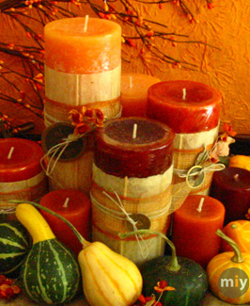
All thanks and praise,
Lord, be given unto you.
All glory this day in the things that we say and do.
In our songs of praise,
in our words of prayer,
in the moments of silence too, all thanks and
praise be given,
Lord, be given unto you.

Slide 4
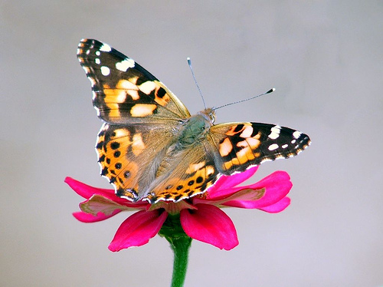
Lord, the blessings
you give us we cannot repay;
they come by grace from above,
but with spirits rejoicing,
our hearts will proclaim
the depth of your love.

Slide 5
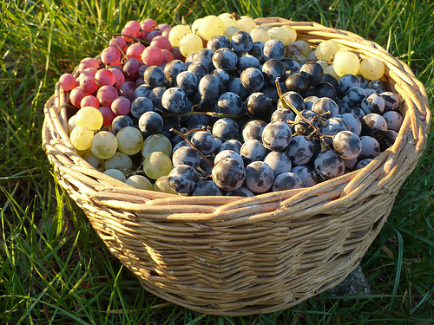
So come let us sing a song to the Lord, a song of glory and praise.
Oh come let us serve Him with hearts full of joy, giving thanks to Him this day.

Slide 6

All thanks and praise,
Lord, be given unto you.
All glory this day in the things that we say and do.
In our songs of praise,
in our words of prayer,
in the moments of
silence too, all thanks and
praise be given,
Lord, be given unto you.

Slide 7
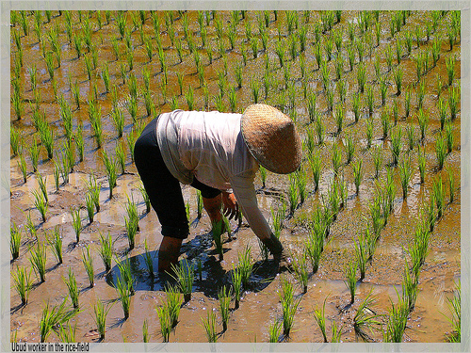
All thanks and praise,
Lord, be given unto you.
All glory this day in the things that we say and do.
In our songs of praise,
in our words of prayers, in the moments of silence too. All thanks and praise be given, Lord, be given unto you.

Slide 8
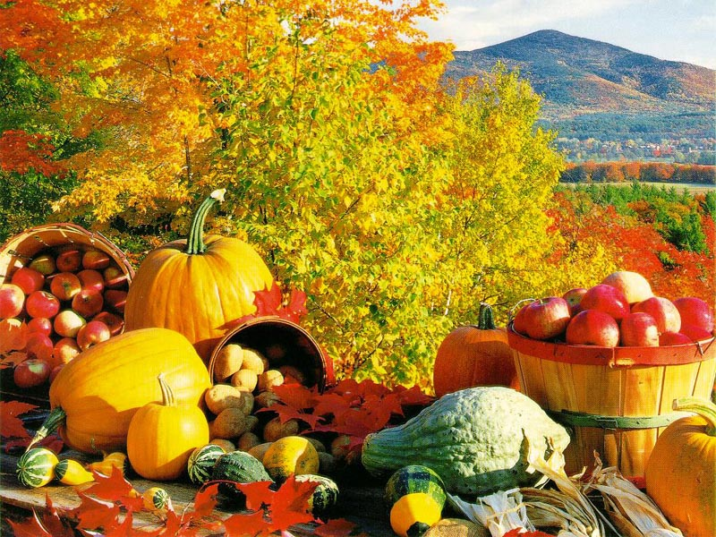
Lord, we give you now all thanks and praise!

