Slide 1
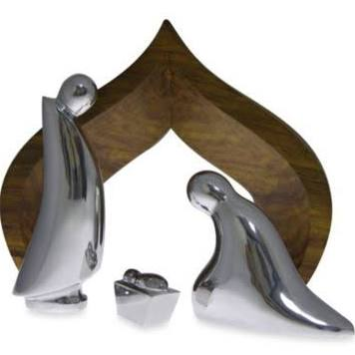
Quiet night , wondrous sight,
In the heavens a star shining bright.
One fair maid, One small babe
there in a manger gently is laid.
平安夜，奇妙夜，
靜夜星空明星輝煌，
一童女，
將嬰孩輕放在馬槽
安然入睡。

Slide 2
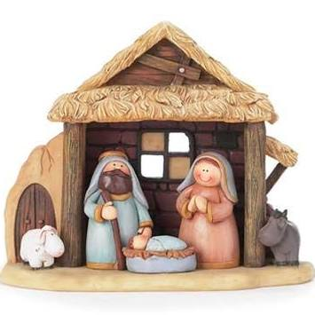
In a lowly stable,
safe from the winter cold.
Sleeps a child, tiny child,
sent on this night for all to behold.
簡陋卑微馬棚，
幸能遮蔽寒風，
小聖嬰，乖乖睡，
今夜將要流傳
到萬代。

Slide 3
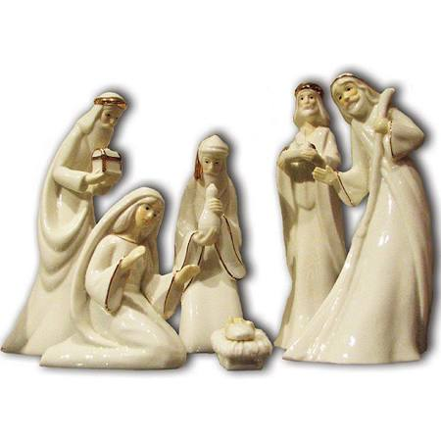
Winter sky, star to guide;
shepherds come to kneel
at His side.
Wise men three,
bended knee,
嚴冬夜，星燦爛；
牧人前來跪主腳前，
三博士，遠道來，

Slide 4
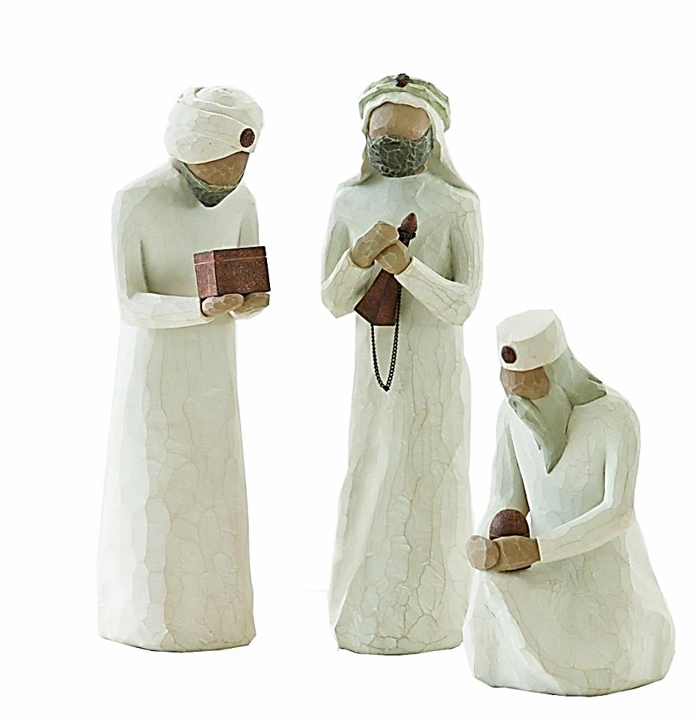
come from afar to worship and see.
Enter in and greet Him; offer the gifts you bring.
風塵僕僕屈膝虔敬拜，
進前來敬拜祂；
將禮物獻給祂。

Slide 5
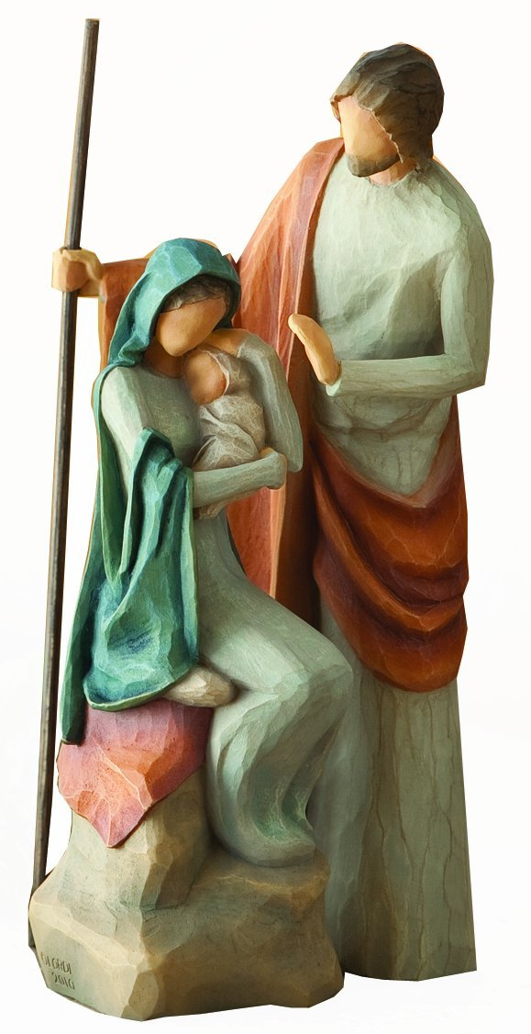
Quite night, wondrous sight;
Bring to us love and peace, little king.
平安夜，奇妙夜，
帶來平安和愛,
小君王。

Slide 6
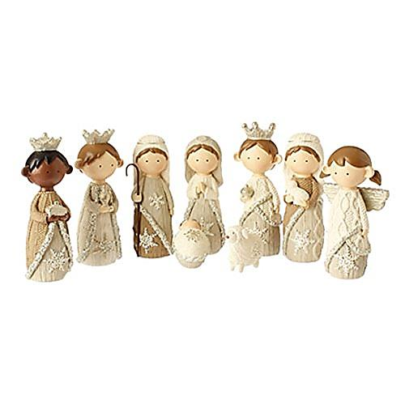
"In Excel sis Deo", joyfully angels sing!
Quite night, wondrous sight; Bring to us love and peace ,little king.
榮耀歸至高神，天使歡欣歌唱！
平安夜，奇妙夜，
帶來平安和愛小君王。

Slide 7

以賽亞書 第9章
2.行佇黑暗中的百姓看見大光；
徛起佇死蔭的地的有光照他們
The people walking in darkness
have seen a great light; on those
living in the land of deep darkness
a light has dawned.

Slide 8
6.因為有一個嬰仔為咱來出世，
有一個子賞賜咱；伊欲負擔國政，伊的名稱做奇妙，謀事，全能的上帝，永遠佇teh 的父，和平的人君。
For to us a child is born, to us a son is given, and the government will be on
his shoulders. And he will be called Wonderful Counselor, Mighty God, Everlasting Father, Prince of Peace. Of the greatness of his government and peace there will be no end.

Slide 9
7.伊的國政及平安欲加添無窮盡。就是佇大衛的寶座及伊的國，欲用審判公義來建立伊保護伊，對今到永遠。萬軍的耶和華的熱心欲成此個事。
He will reign on David’s throne and over his kingdom, establishing and upholding it with justice and righteousness from that time on and forever. (Isaiah 9:2,6-7)

Slide 10
歌羅西書第1章
12.閣感謝父，因為伊互咱堪得有份聖徒的業佇光明的所在。
13.伊已經救咱脫離黑暗的權勢，
來搬徙咱入伊所疼的子的國；
Give joyful thanks to the Father, who has qualified you to share in the inheritance of his holy people in the kingdom of light.

Slide 11
14. tiàm佇伊咱得著贖回，
就是咱的罪赦免。
For he has rescued us from the dominion of darkness and brought us into the kingdom of the Son he loves, in whom we have redemption, the forgiveness of sins.
(Colossians 1:12-14)

Slide 12

歡喜歡喜阮謳咾祢，
歸榮光於光的主
天使唱歌大稱讚祢，
大聲唱透聖誕冥
Joyful, Joyful, We Adore You,
God of glory, Lord of light;
Angels lifting praise before you
Sing through out this holy night.

Slide 13
在馬槽裡的聖嬰仔，
溫純可愛神的子
大家歡喜同唱歌聲，
謳咾祢所賜的疼
In a manger lies a baby,
Child of Mary, Son of God.
Voices joined in joyful chorus
Praise You for Your gift of love.

Slide 14
聖的疼到極好仁愛，
真的歡喜從天來，
祢謙卑來與阮同在，
攏是信實與慈愛
Love Divine, all loves excelling,
Joy of heaven,
to earth come down;
Fix in us your humble dwelling;
All Thy faithful mercies crown.

Slide 15
祢的聖工是祢榮光，
全地謳咾祢齊全
全地謳咾歡喜出聲，
基督新生王尊名
All Your works declare
Your glory, All creation joins
to sing; Praise resounds as
earth rejoices, In the birth
of Christ the King.

Slide 16
牧者跪拜在嬰仔前，
哨角歌聲奏無停，
今咱的心著受舉起，
奇妙的愛與歡喜
Shepherds kneel before
the Infant; Trumpets sound
and anthems raise, As with joy
our hearts are lifted, Joined
in wonder, love, and praise.

Slide 17
聖的疼到極好仁愛
真的歡喜從天來
Love divine,
all loves excelling,
Joy of heaven,
to earth come down.

