Slide 1

凡若人有憂悶傷悲

Slide 2
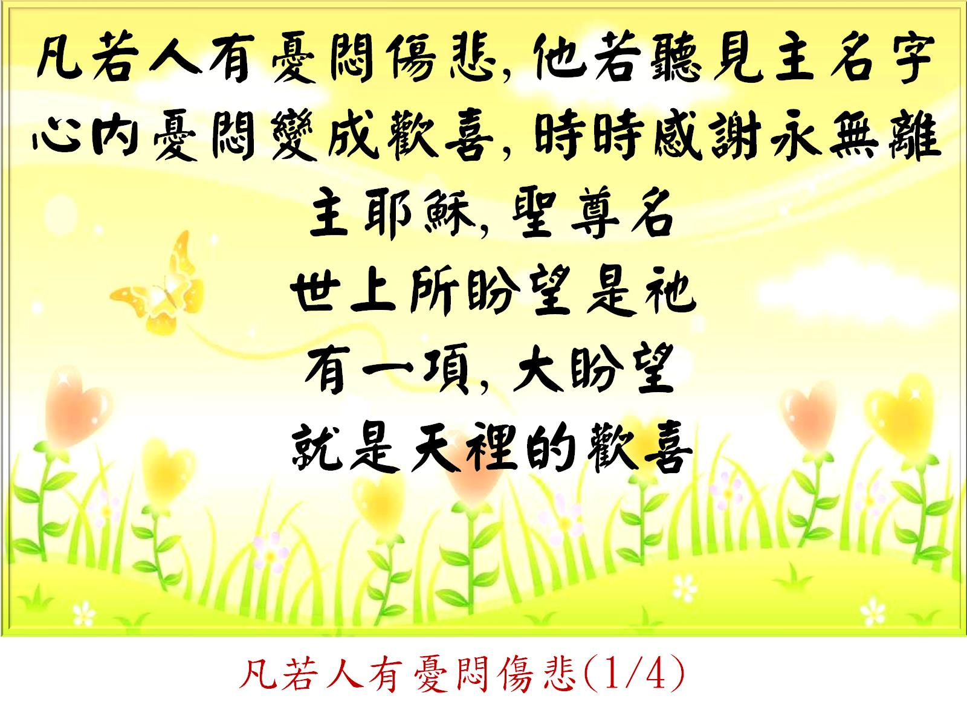
凡若人有憂悶傷悲(1/4)

Slide 3
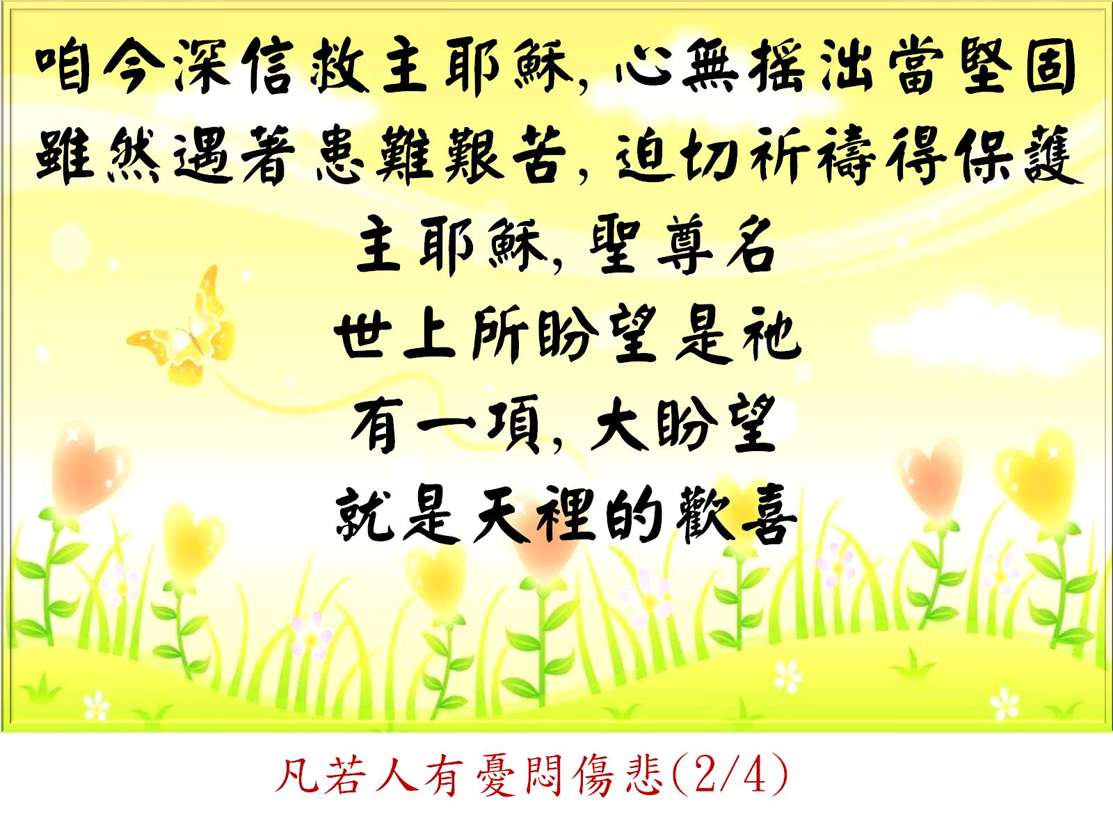
凡若人有憂悶傷悲(2/4)

Slide 4
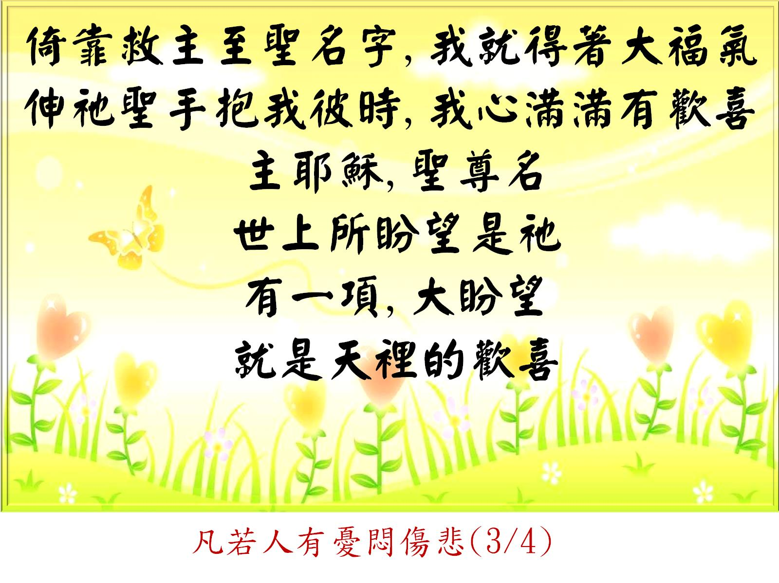
凡若人有憂悶傷悲(3/4)

Slide 5
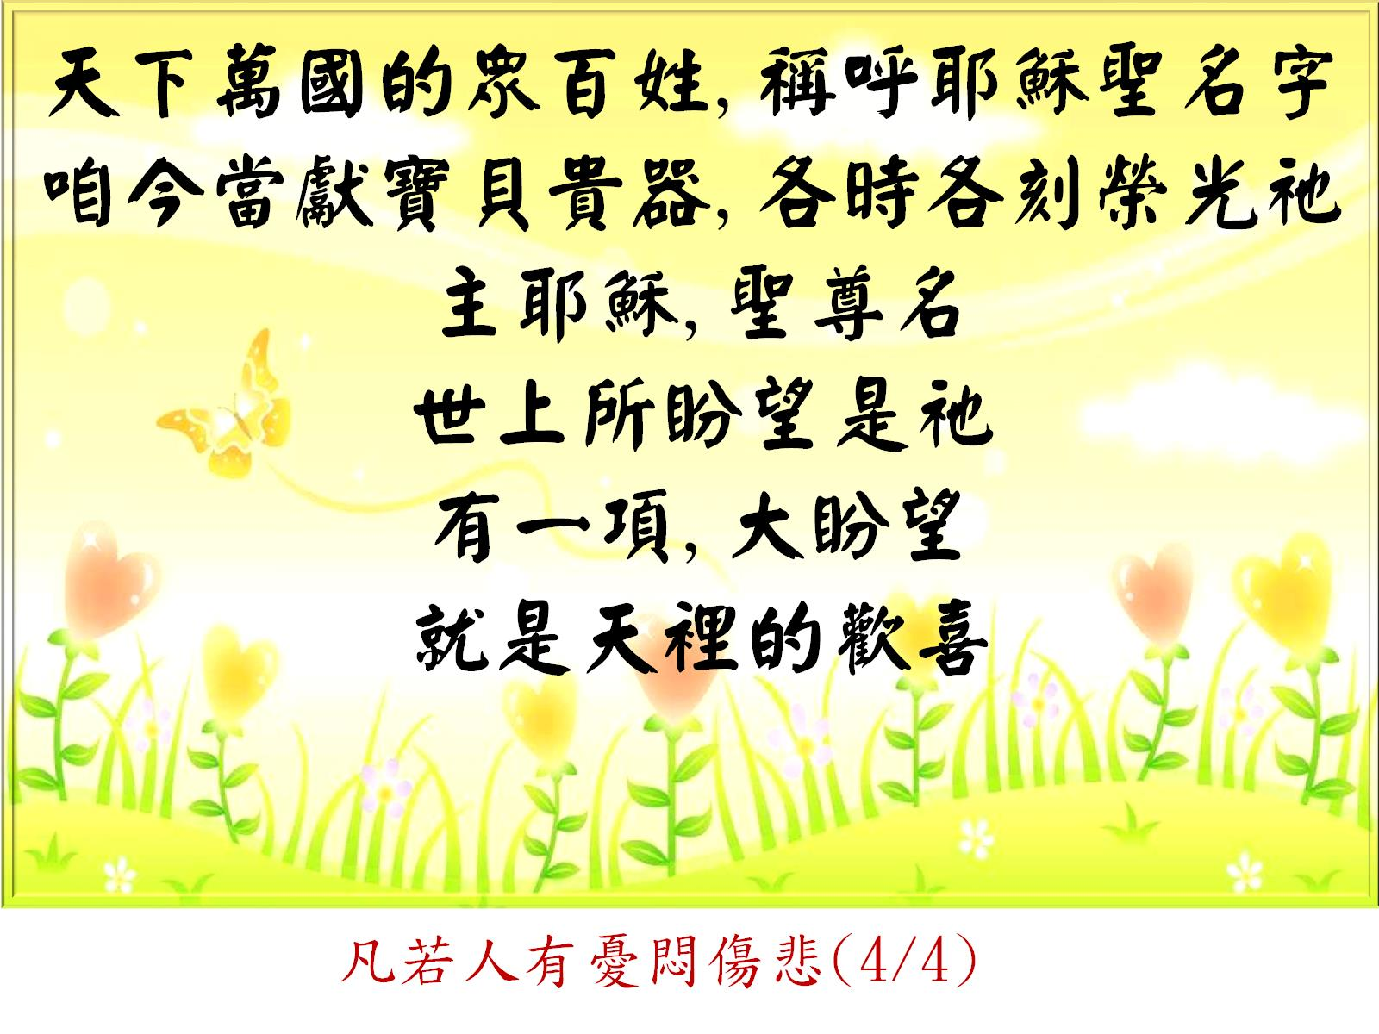
凡若人有憂悶傷悲(4/4)

