Slide 1
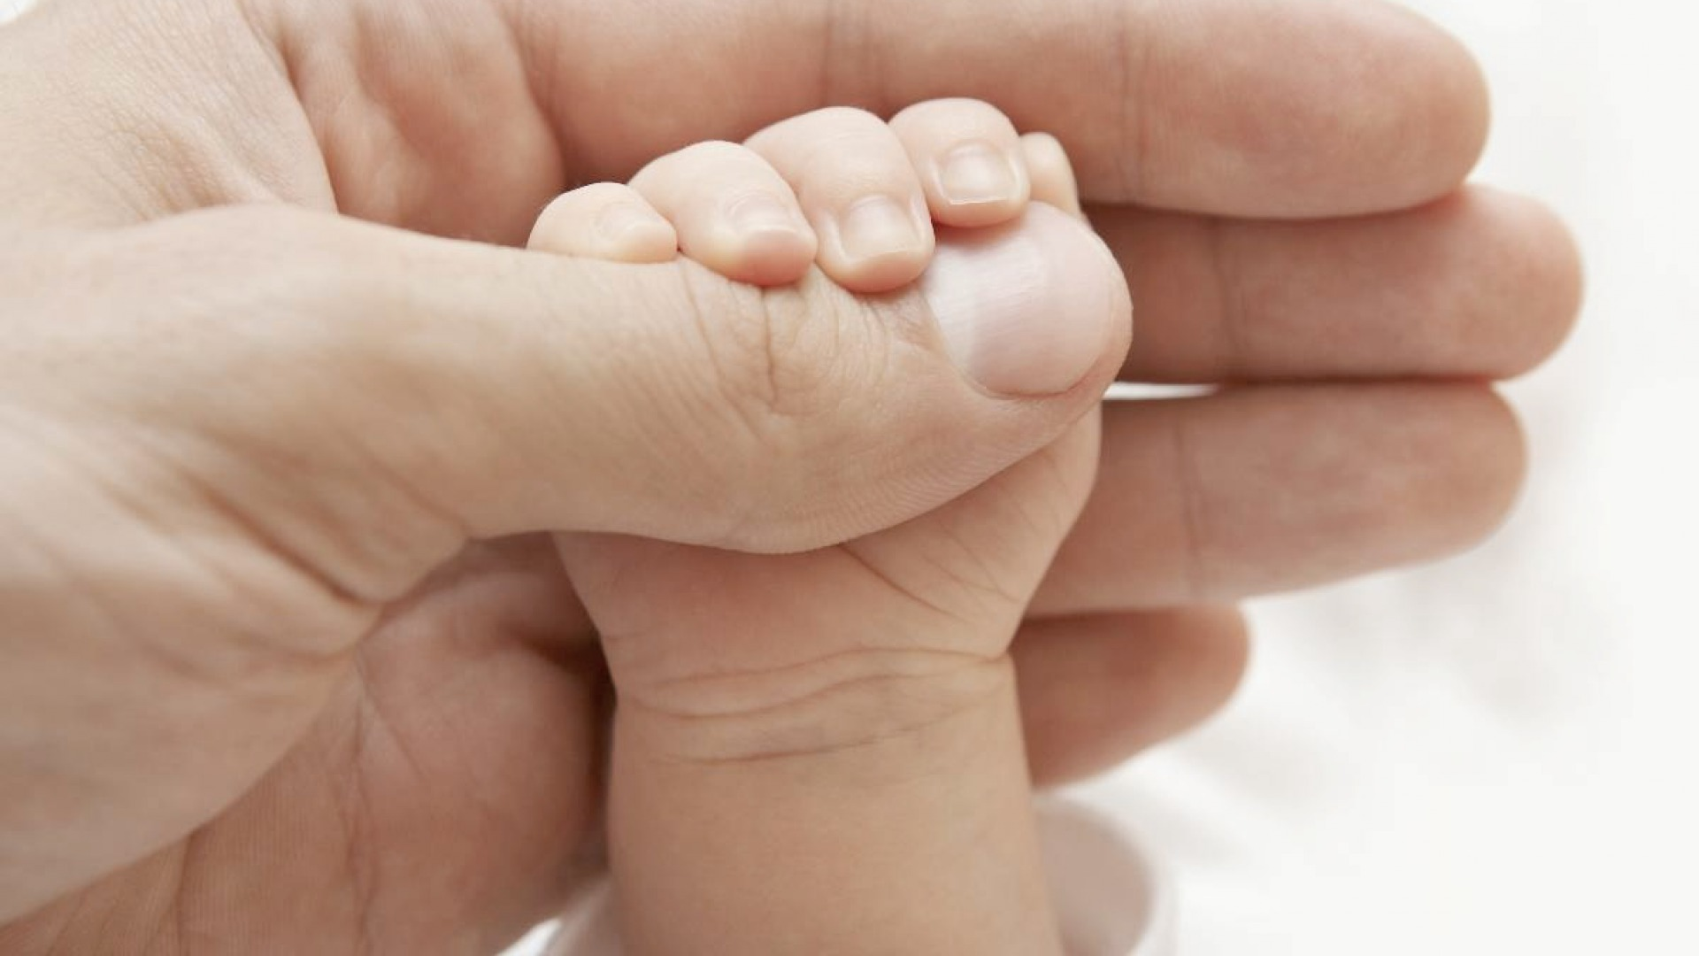
媽媽的手
Mother’s Hands

Slide 2
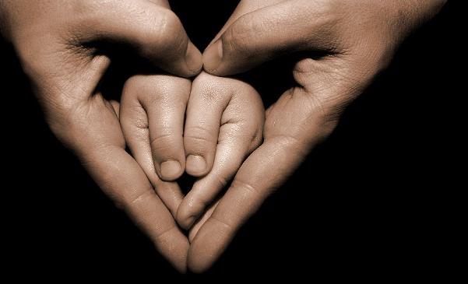
媽媽的手像春日和風
充滿溫馨地吹拂過我心
在黑暗的角落有多少汗水滴落
總為我們她不言語
Mother’s hands are like the spring gentle breeze, a warm breath of air touching my heart.
Quietly working behind the scene, she toiled and sweated, just for us.

Slide 3
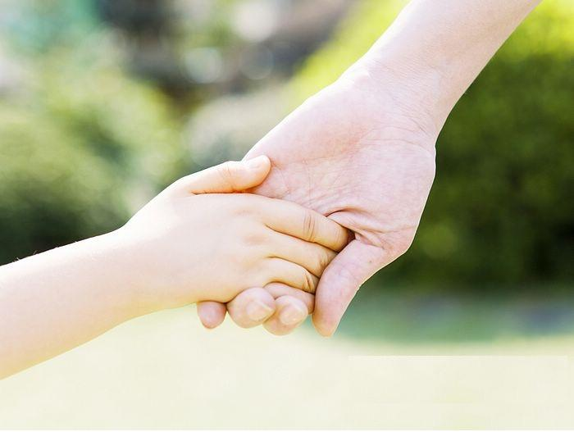
媽媽的手像冬日陽光
充滿溫暖地照射過我心
在無數的夜晚
為我們獻上祈禱,
像我們的天使
Mother’s hands are like the warm winter sun, filled with warmth and shines through my heart.
She prayed for us countless nights,
like our angel.

Slide 4
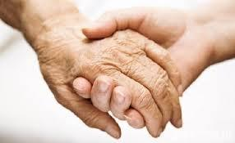
媽媽 妳曾否為自己禱告
媽媽 願神祝福妳
媽媽的手 天使的手
將是充滿青春快樂的手
Oh mother, did you pray for yourself.
May God bless you, mother.
Mother’s hands are like angle’s hands,
youthful and full of joy.

Slide 5
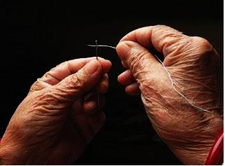
媽媽的手像春日和風
充滿溫馨地吹拂過我心
在黑暗的角落有多少汗水滴落
總為我們她不言語
Mother’s hands are like the spring gentle breeze, a warm breath of air touching my heart.
Quietly working behind the scene, she toiled and sweated, just for us.

Slide 6
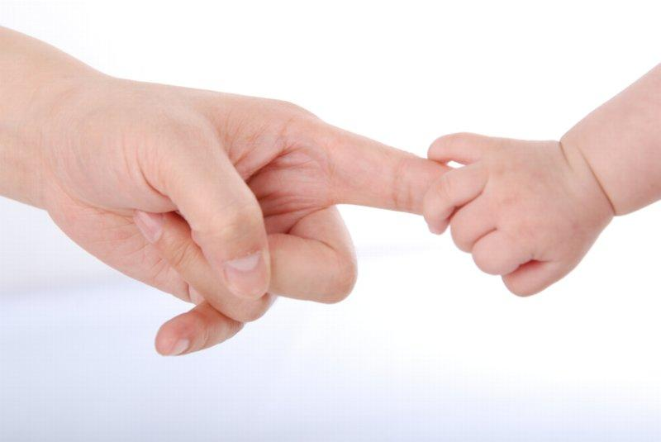
媽媽的手像春日和風
充滿溫馨地吹拂過我心
在黑暗的角落有多少汗水滴落
總為我們她不言語
Mother’s hands are like the spring gentle breeze, a warm breath of air touching my heart.
Quietly working behind the scene, she toiled and sweated, just for us.

Slide 7
媽媽 妳曾否為自己禱告
媽媽 願神祝福妳
媽媽的手 天使的手
將是充滿青春快樂的手
Oh mother, did you pray for yourself.
May God bless you, mother.
Mother’s hands are like angel’s hands,
youthful and full of joy.

