Slide 1

God with us, Emmanuel with us:
the King of Kings and Lord of lord, God is with us!
God with us! Redeeming Love for us: eternal God come down to earth. God is with us!
主同在，以馬內利的主，
萬王的王，萬主的主與咱同在。
主同在，為著疼贖回咱。
永遠的主降臨地上與咱同在。

Slide 2
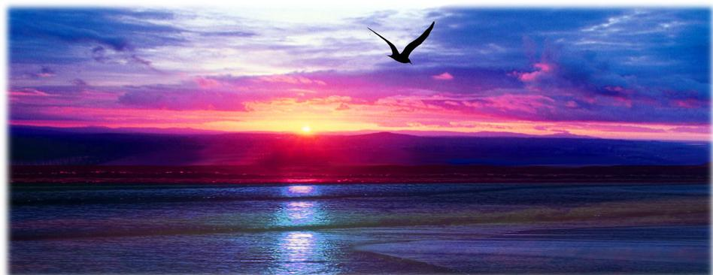
In the beginning was the Word,
and the Word was with God.
In the beginning was the Word,
and the Word was with God.
佇起頭有創造的道，這道就是上帝。
佇起頭有創造的道，這道是上帝。

Slide 3
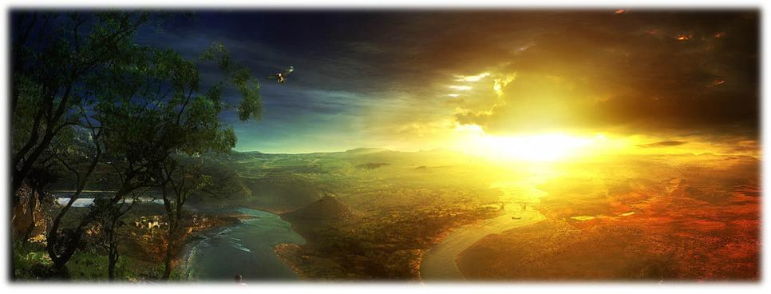
God with us, Emmanuel with us:
the King of Kings and Lord of lord,
God is with us !
主同在,以馬內利的主，
萬王的王，萬主的主與咱同在。

Slide 4
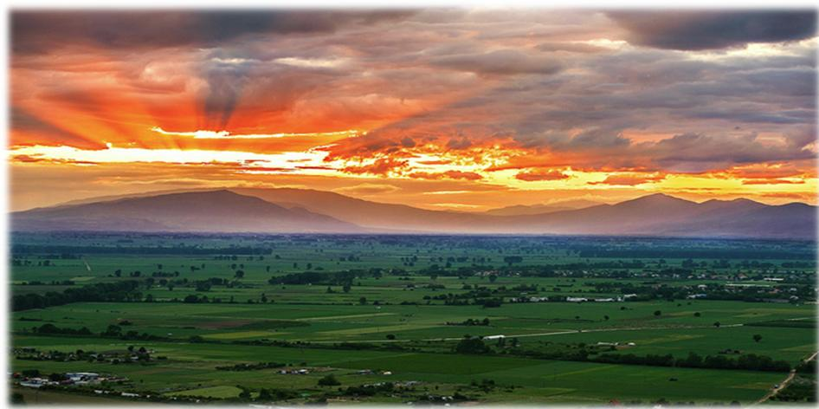
God with us! Redeeming Love for us: eternal God come down to earth.
God is with us!
主同在，為著疼贖回咱。
永遠的主降臨地上,
與咱同在。

Slide 5
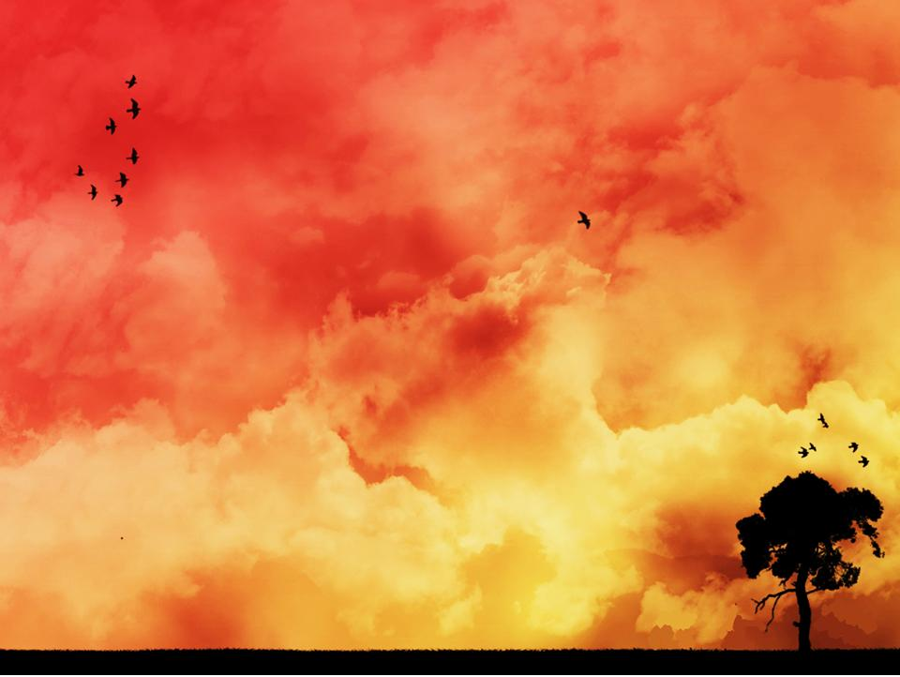
The Word became flesh and lived among us; the Word became flesh to live among us.
We have seen the glory,
We have seen God's glory
of the One and the Only Son,
full of grace and truth God is with us!
這道成肉體，居起咱中間;
這道成肉體，居起咱中間。
阮看見祂榮光，阮看見祂榮光，
獨生子榮光充滿恩典與真理,與咱同在。

Slide 6
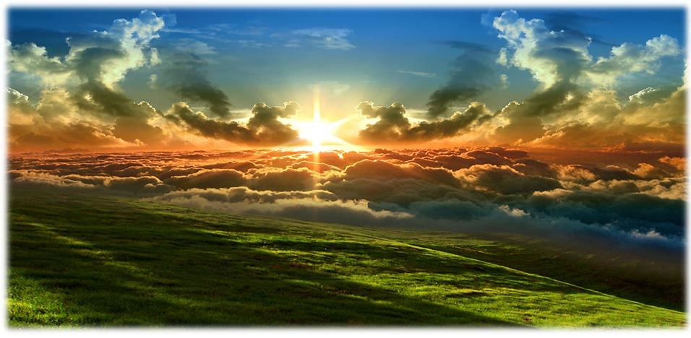
God with us, Emmanuel with us:
the King of Kings and Lord of lord,
God is with us now and evermore!
主同在,以馬內利的主，
萬王的王，萬主的主
與咱同在對今到永遠。

Slide 7
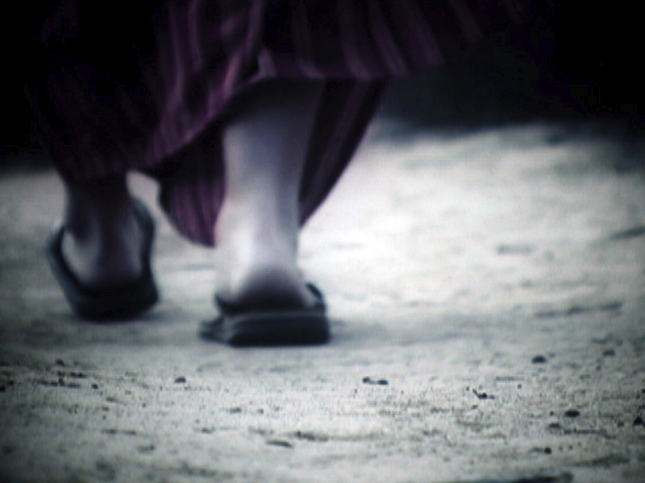
John 約翰
I was one of those persons challenged to answer that question from Jesus. “Who do you say that I am?”
當耶穌問“你們說我是是誰？” 的時，我也是受挑戰回答這問題的人之一。

Slide 8
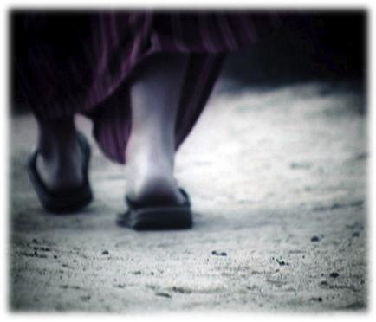
Well, I thought I knew who I was:
John, a fisherman, brother to James, son of Zebedee.
哦，我當然知道自己是誰:一個打魚的，雅各的兄弟，西庇太的兒子。

Slide 9
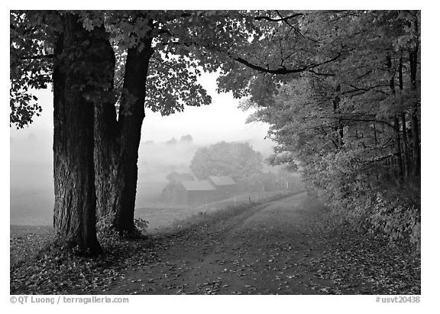
But then one day while my brother and
I were fishing, Jesus shows up and says, ”Come……follow me.” So I did!
There was something compelling about
this Man. And it began the most amazing journey of my life.
但是有一天當我兄弟和我正在打魚時，耶穌走來招呼說”來跟我。”我就馬上跟祂。祂是一個很會曉呼召的人。就這樣開始我一生最奇妙的旅程。

Slide 10
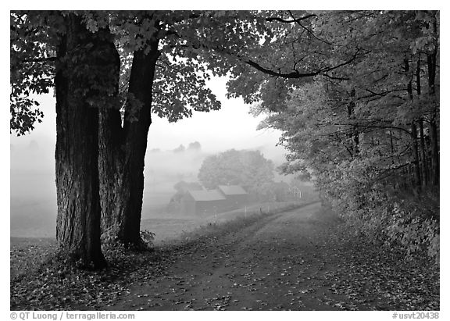
It quickly became clear that Jesus was a special messenger sent from above to share the love and grace of God.
This was truly God living among us, in the flesh, speaking truth with wisdom and insight like none had ever heard.
無久， 我明白耶穌是一位從天頂來的特殊傳道者，祂來分享上帝的疼和恩典。
祂是神，用人子的身份，住在咱中間。用人不曾聽過的智慧宣揚道理。

Slide 11
I began to understand that God so loved the world – all of us – that He was willing to send His only Son to give the gift of eternal life. Redeeming love was the prevailing theme of this Man’s life during those three brief years that I shared with Him.
我開始明白上帝是chiá nih疼世間人，甚至將祂的獨生子賜給咱，當做永生的禮物。救贖的疼是祂一生得勝的主題，這是我和祂逗陣短短三年的領受。

Slide 12
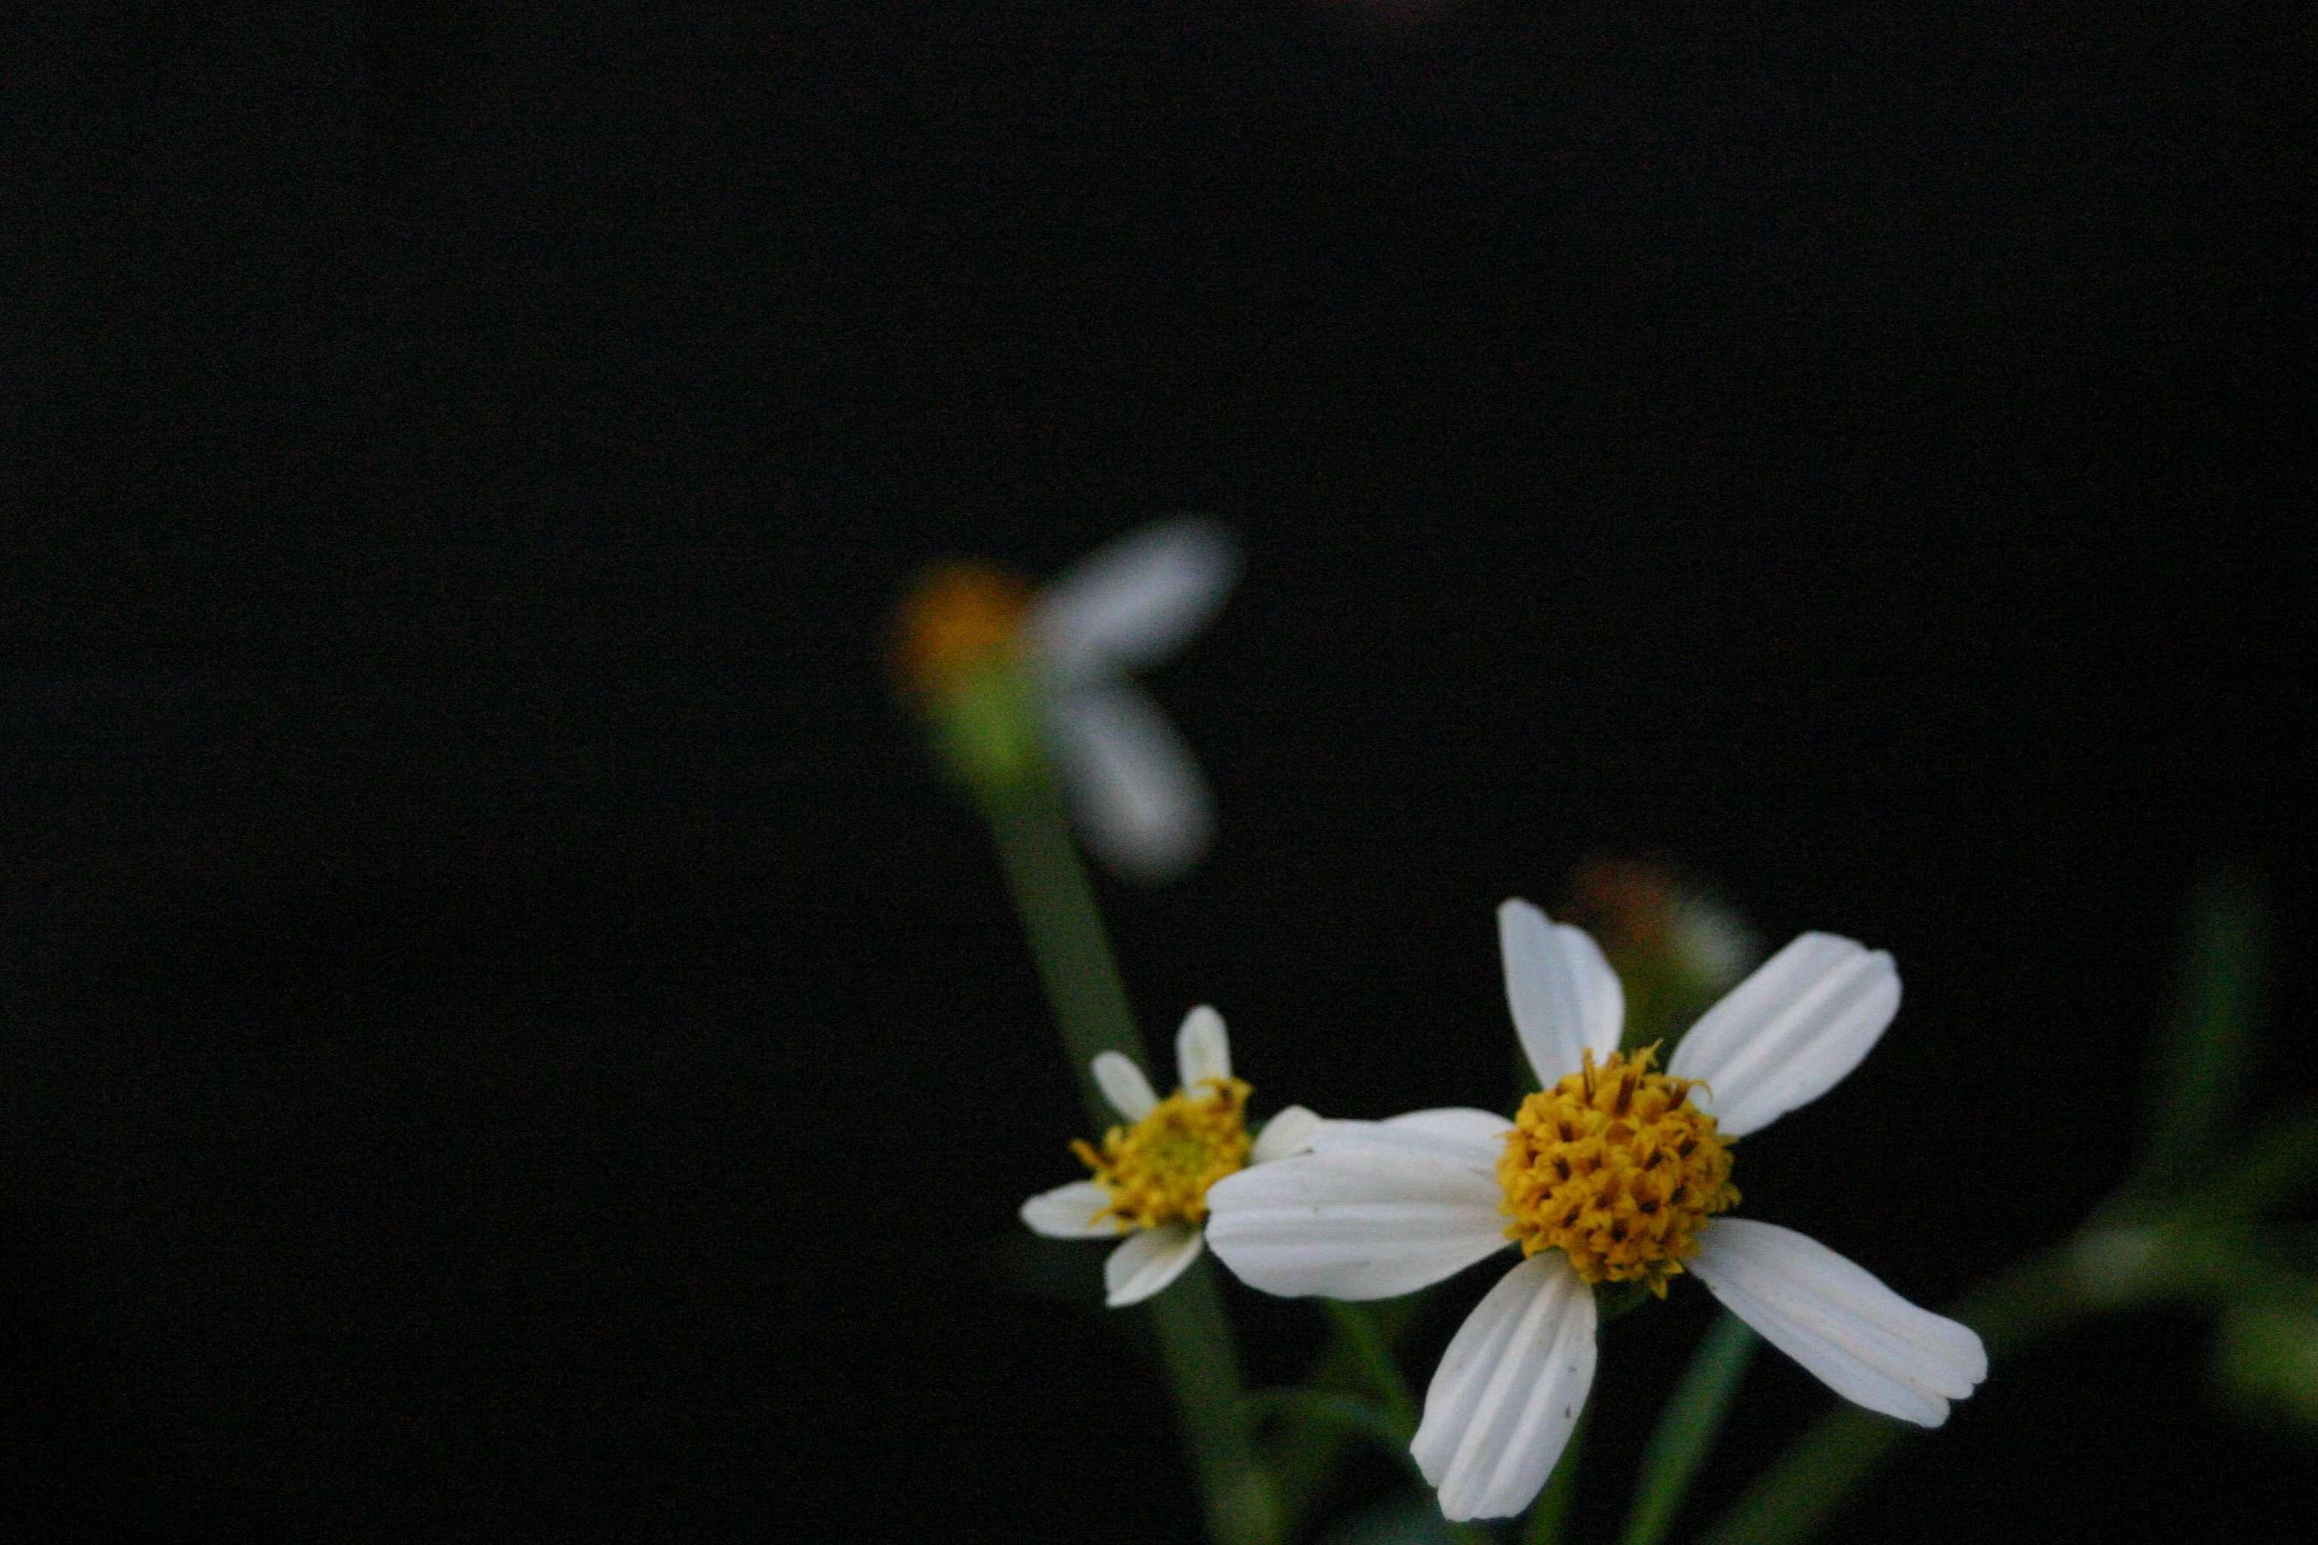
He loved us…He loved me…
and He loved His heavenly Father with a devotion that was unparalleled to anything I had ever seen.
How could I not love Him back?
祂疼咱，祂疼我，
祂疼天父超過一切。
我怎樣能不報答
祂的疼呢?

Slide 13
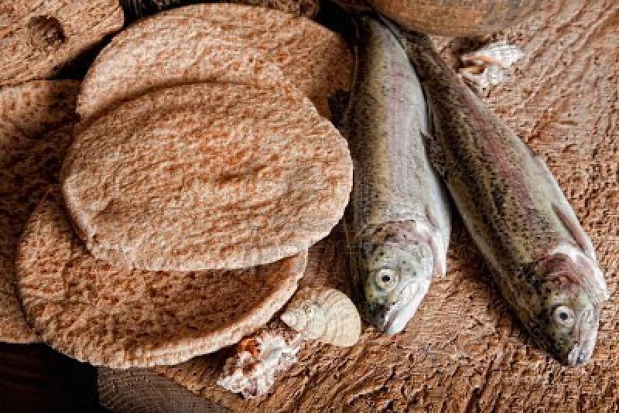
The things I witnessed with my own eyes… they were unbelievable! I saw Jesus turn water into wine. I saw people healed in miraculous ways.
I saw Him feed thousands with just a few loaves of bread and fish.
我親目見証的事，是真正奇妙的!
我看見耶穌將水變為酒，
我看見人奇妙的得到
醫治，我看見祂用五塊
餅兩尾魚餵飽五千人。

Slide 14
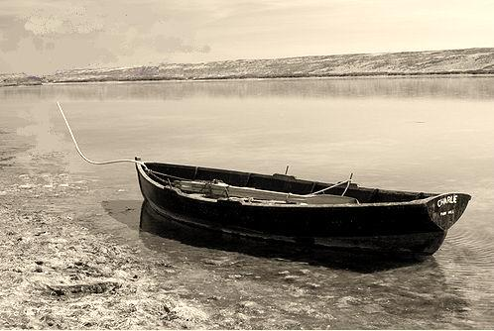
He made the blind see, raised the dead
to life, walked on water, calmed stormy seas… and He shared the love of God with all of us in these acts!
祂使睛瞑的能看見，使死的人復活。行在水面上，平靜海上的風浪……，並且在逐項事和咱分享上帝的疼ΩΩΩ∞∞∞

Slide 15
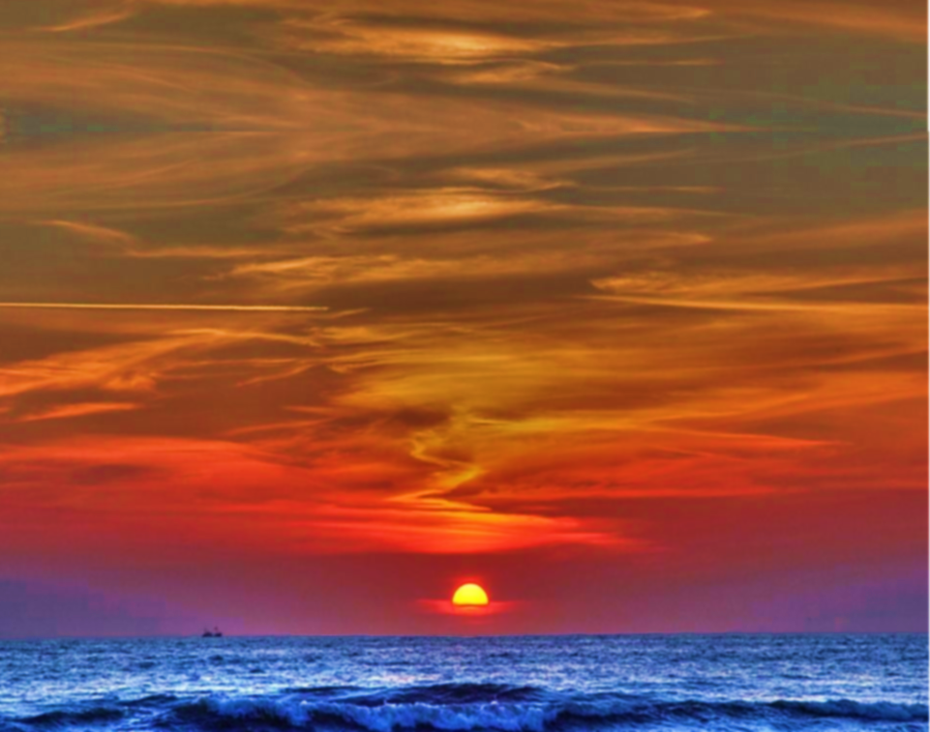
咱的救主， 是風與海的主，
平靜風浪，祂又拯救我。
咱的救主，是風與海的主，
醫好跛腳，互睛瞑看見。
He is the Lord of the wind and the sea.
He calmed the storm and He rescued me.
He is Lord of the wind and the sea.
He healed the lame,
made the blind to see.

Slide 16
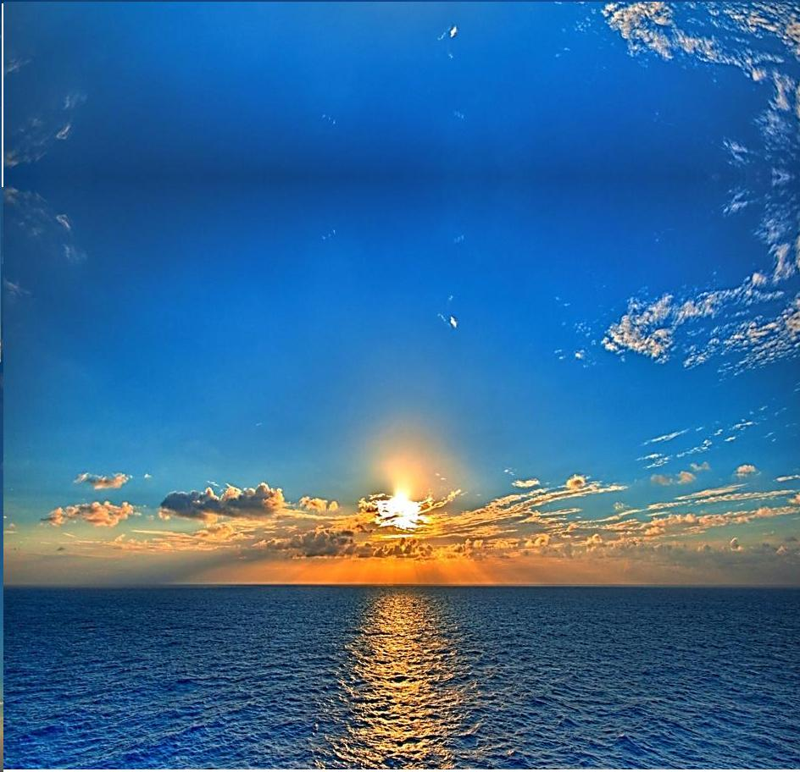
主耶穌謙卑，木匠的子，
是上帝顯明成做聖子。
服務眾人，勇壯與軟茈
賜真理互尋求祂的。
Jesus the humble carpenter's Son, reveiled by God as the Holy One! Servant to all, the strong and the weak, with truth He comes to those who seek.

Slide 17
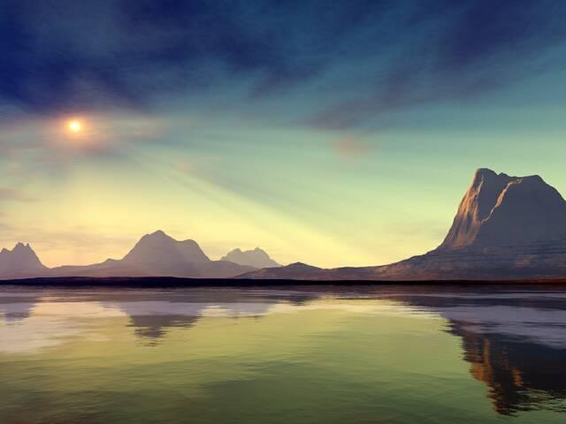
咱的救主， 是風與海的主。
平靜風浪， 祂又拯救我。
咱的救主， 是風與海的主。
醫好跛腳， 互睛瞑看見。
He is The Lord of the wind and sea.
He calmed the storm
and He rescued me.
He is Lord of the wind and the sea.
He healed the lame,
made the blind to see.

Slide 18

祂互水變做好的酒，
用上帝權能互人復活。
在一個山邊，祂用五餅
以及兩尾魚，來養飼眾人。
He turned the water into wine,
He raise the dead by God's pow'r divine. On the mountainside.
The crowd was fed with few small fish and some loaves of bread.

Slide 19
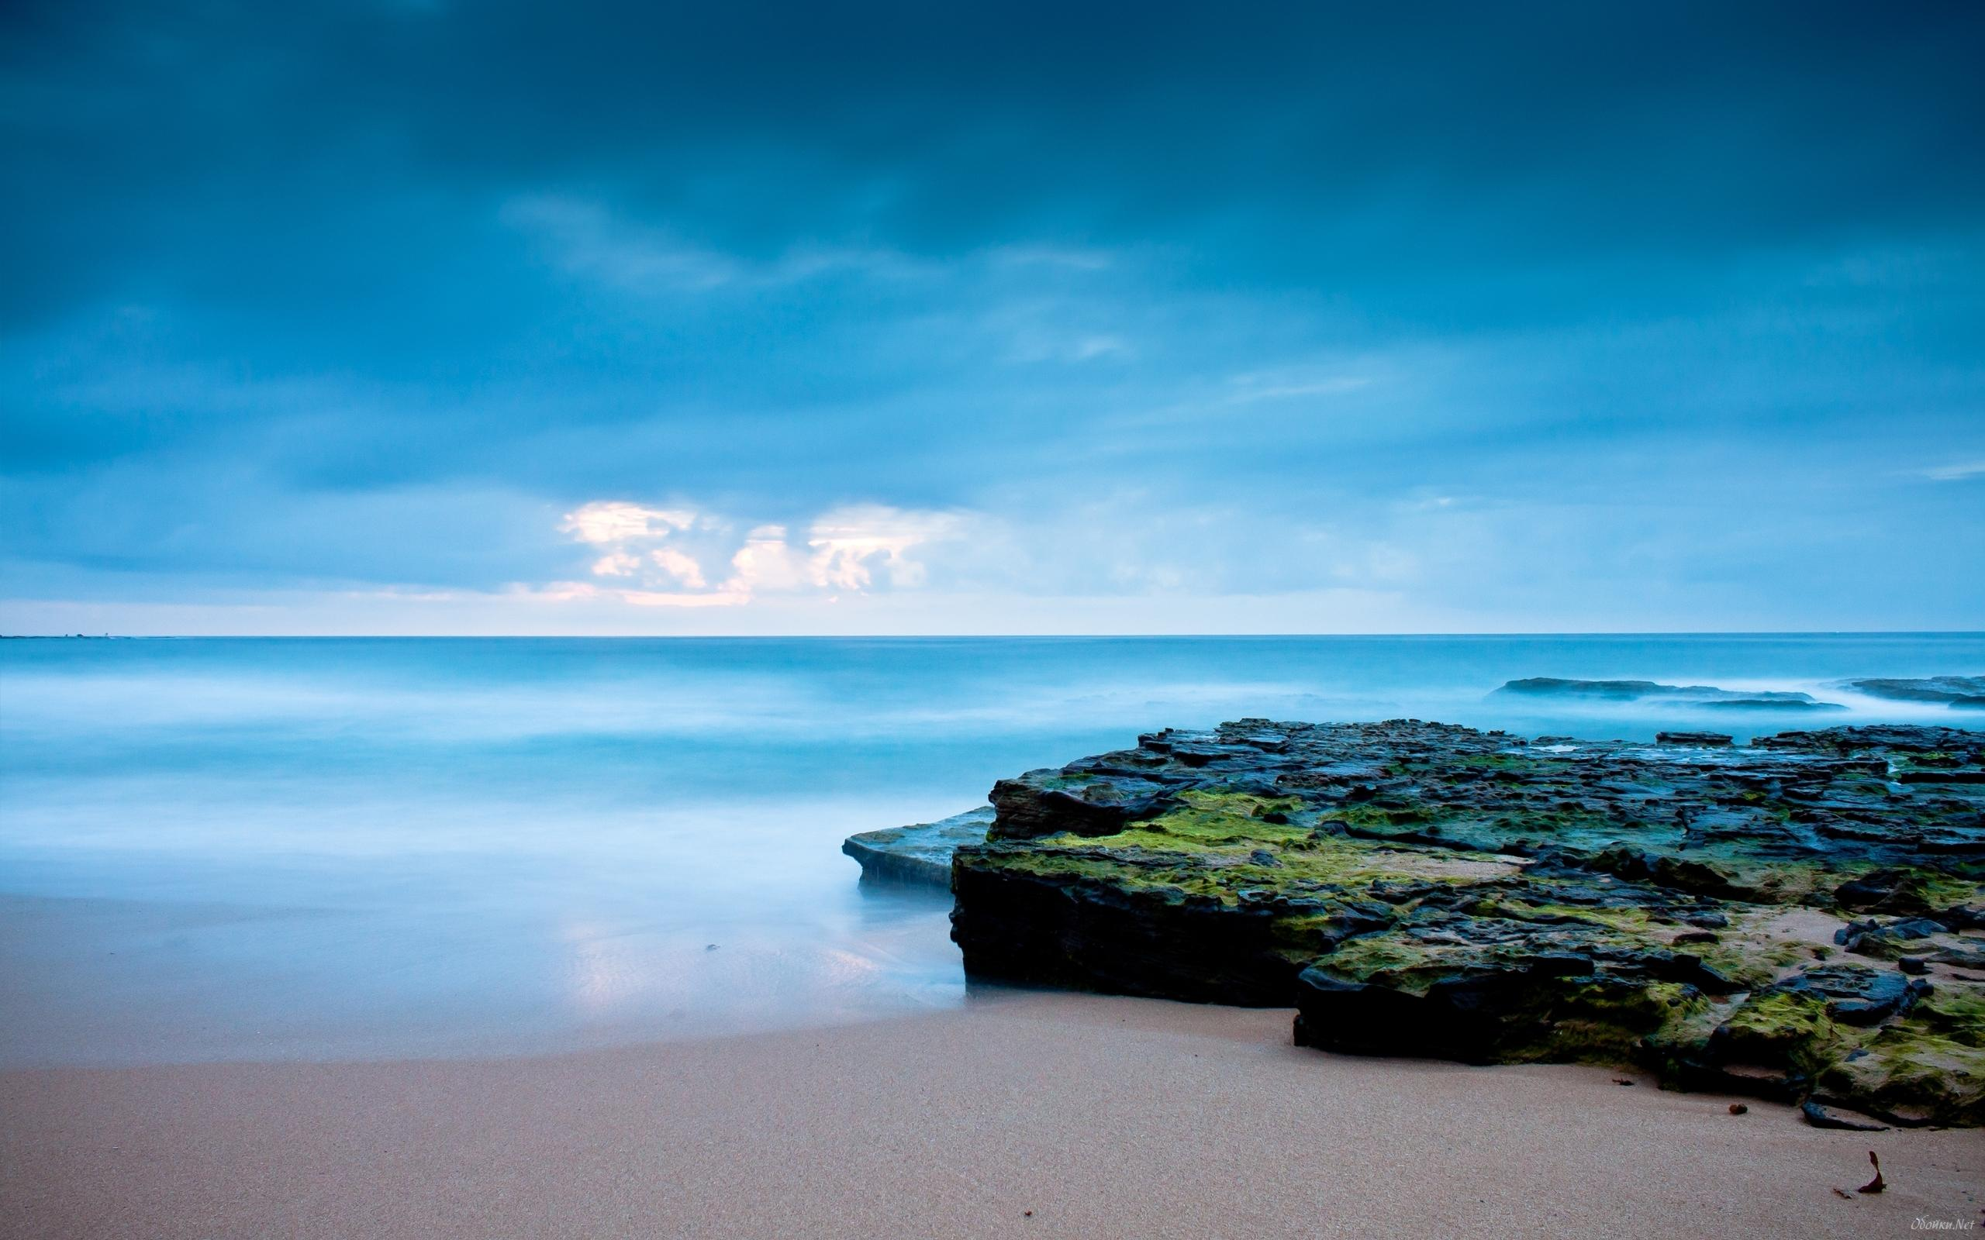
主極疼世間，
祂賞賜獨生聖子，
互凡若信祂的會得永活。
God so loved the world that
He gave His only Son, that all
who believe in Him might be won

Slide 20
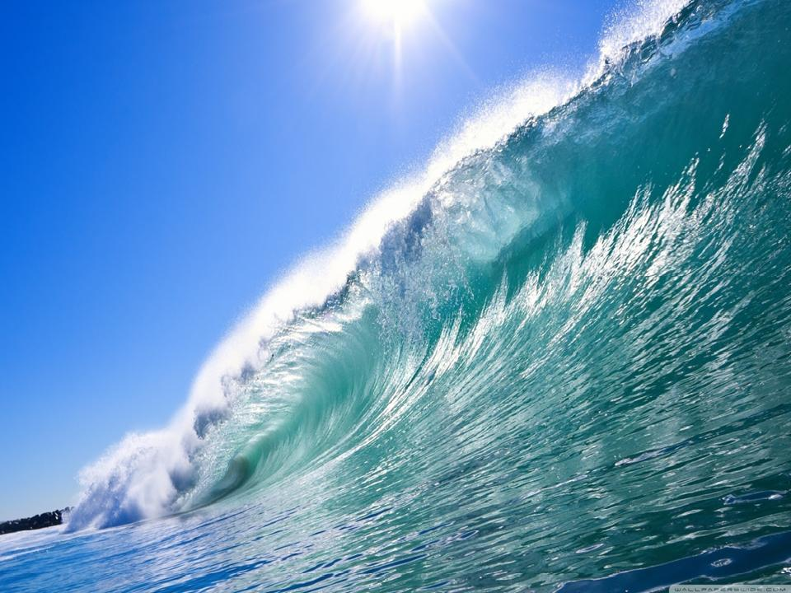
咱的主是風與海的主
加利利來的教師。
咱的主，是風與海的主。
to The Lord of the wind and the sea, the Teacher from Galilee.
He is Lord of the wind and the sea.

Slide 21
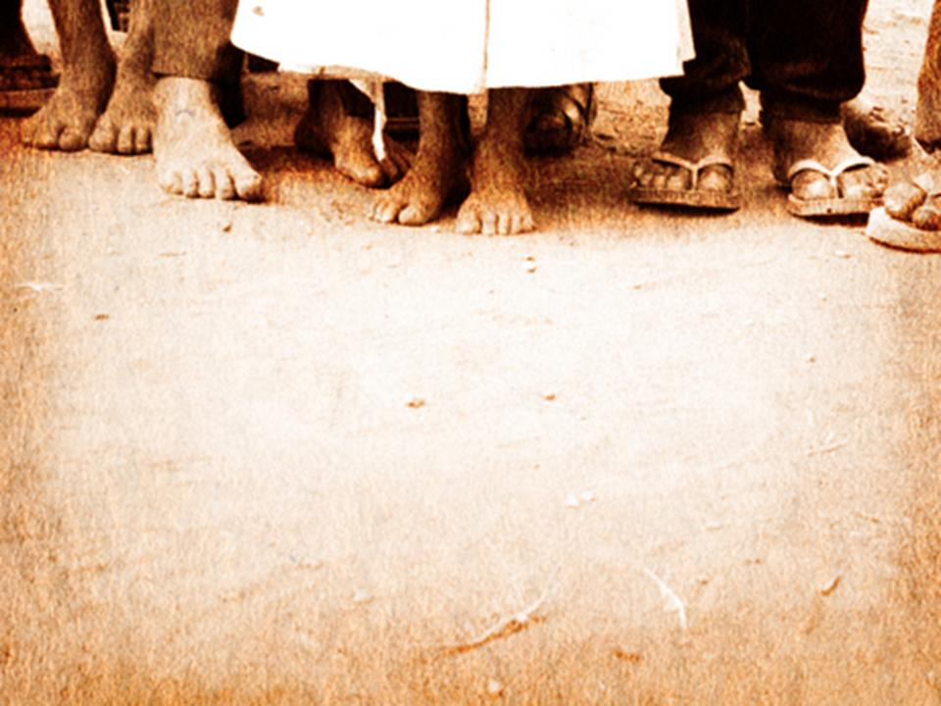
Jesus calls me “Peter.” Some rock!
But I once sliced off a man’s ear in anger.
耶穌叫我是「彼得」，是磐石。
但是我曾在生氣中，無法節制，
削去人的耳朵.

Slide 22
I often said and did things I later regretted.
I even denied Him even I know Jesus.
I didn’t mean to do it…didn’t want to do it.
I was like sand in the heat of life’s battle.
我知耶穌是主，但在驚惶中，
我也曾瞴認伊。所以，
我在人生的征戰中，親像沙土。

Slide 23

The religious leaders were like blind men who couldn’t see the truth standing in front of them. They were skeptical of His claims and characterized His miracles as deception, and they agree: Jesus was their enemy.
阮的公會是睛瞑的，看不到在他們眼前的真道，唔接受耶穌是彌賽亞，唔受他的教示，唔認他的神蹟，
拿耶穌當讎敵。

Slide 24
“How can the Messiah come from our own community?” they would ask. Jesus warned those of us who were close to Him to be careful around them…to not be deceived.
阮也曾卬愕，但主提醒阮，
不可受他們的迷惑。

Slide 25
One day Jesus asked us: “Who do you say that I am?” Well, I responded impulsively, as I’ve been known to do: ”You are the Christ, the son of the living God!” I knew my words were true! I had a front row seat to this Man’s life and ministry.
主問我們學生說：「您說我是誰？」
我受感動，大膽說：「您是基督，是真活上帝的兒子!」我知這句話是實在的，因為我親身經驗祂的生命和事工。

Slide 26

The religious leaders gathered; they were looking for a sign.
" People say You are the Son of God, both human and divine.
宗教領袖大家聚集，
怹在找一個證明，
眾人講你是上帝的子。
是人也是神聖。

Slide 27

But if You are the Promised One, Messiah, King of the kings, then prove to us,
so there's no doubt, and we will gladly crown You as the Christ, the Son of God!
Are You the Christ?
The Son of the living God?
你若是那個應允的彌賽亞、
王之王，對阮證明攏無僥疑，
阮就欲相信你是主基督，上帝的子。
你豈是主，真活上帝的聖子？

Slide 28
Are you the Christ?
The holy, righteous Lord?
Some claim You're John the Baptist, or some ancient prophet.
Are You the Christ,
the Son of the living God?“
你豈是主，聖閣義的基督？
有人稱你洗禮約翰，
或是古早先知, 你豈是主，
真活上帝的聖子？

Slide 29

Jesus gathered His disciples
and He warned them tenderly,
" Now be wise, resist the teachings
of those who would deceive.“
耶穌聚集祂的門徒，
溫柔提醒著警醒，
“有智慧，小心受教示。
免得受怹迷惑。”

Slide 30
The Jesus asked the faithful few,
"Who do you say that I am?"
With boldness Peter answered
as he faced the Son of Man.
"You are the Christ, the Son the God!
You are the Christ, the Son of the living God!
耶穌叫祂的門徒來,問怹你講我是誰?
大膽的彼得在人子的面前回答講
“祢是基督,上帝聖子
祢是基督真活上帝的聖子!

Slide 31
You are the Christ, the holy,
righteous Lord!
Some claim You're John the Baptist,
or some ancient prophet.
你是基督，是聖閣義的主.
有人稱你洗禮約翰，
或是古早先知.

Slide 32
Your are the Christ,
the Son of the living God!
You are the Christ, the holy Christ,
the Son of the living God.”
你是基督，真活上帝的聖子！
你是基督，至聖基督，
真活上帝的聖子!

Slide 33
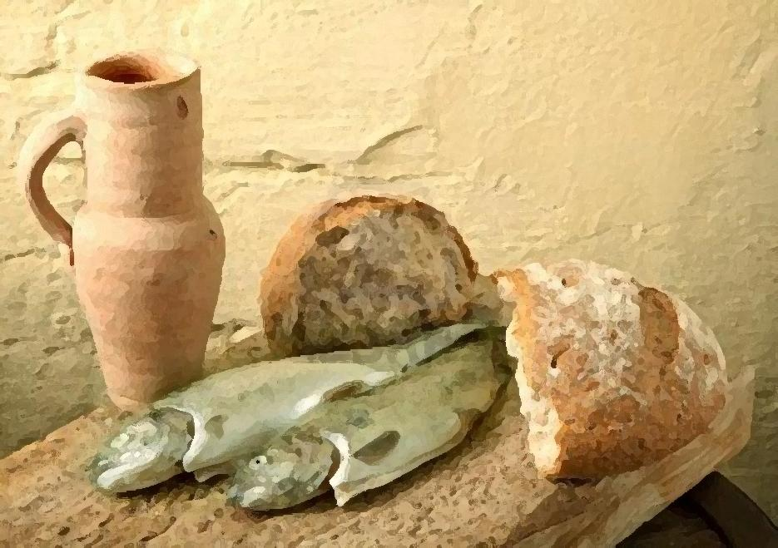
Mary from Bethany
伯大尼的馬利亞
Who is this Jesus?
Well, I thought I knew.
He had stopped by our home in Bethany, just outside of Jerusalem, many times to eat, to rest, and to talk.
這個耶穌是誰?哦，我想我知道。
祂來過耶路撒冷城外伯大尼我的家幾ah’遍，有時吃飯，有時休息，有時也開講。

Slide 34

But this visit was different! We were mourning the death of my brother, Lazarus.
It had been four days when Jesus arrived.
My sister, Martha, had gone out to greet the teacher and then comeback to get me.
“Mary, Jesus wants to see you.”
但這一次跟以前不同!阮是為死去的兄弟拉撒路哀傷。當耶穌來時已經過了四天。我姐姐馬大出去迎接祂，然後回來叫我
說:”馬利亞，先生來了，祂在叫你。”

Slide 35
  I got up and hastily went out to meet Him. “Where is Lazarus?” Jesus asked. We took Him to the tomb. Against our wishes, He insisted that we roll the stone aside.
  我就緊緊起來，到耶穌那裡去。耶穌問“你們將他放在那裡?”阮就帶祂到墳墓那裡。在阮不情願下，祂堅持將墳前的石頭挪開。

Slide 36
Then He shouts:
“ Lazarus, come out! ”
It was moment that still shakes
the very core of my being. ”
然後祂大聲呼叫說:“拉撒路出來!
從那時到現在，猶原給我的全身
感受震動.”

Slide 37
My brother- my dead brother –walks out of the tomb as alive as any of us! As you would expect, word traveled quickly! People everywhere were clamoring to see this Man who could raise the dead to life.
我的兄弟，那已經死了的他，竟然行出來，像你我活著的人一樣，你可以想像，這件事隨時傳開，人們大聲喊講，想看這位能讓死人復活的人。

Slide 38
It wasn’t long before Jesus returned to our home in Bethany. It was just before the Passover Feast and we would soon be joining thousands of others in Jerusalem for this grand festival.
盤過節前六日，耶穌轉到阮在伯大尼的家。有人在那裡給耶穌備辦筵席，阮同齊服事，拉撒路也在那同耶穌坐桌的人中間。

Slide 39
We are together, including Lazarus, and celebrated God’s faithfulness. A few days later we caught up with Jesus as He was entering Jerusalem. There was an unbelievable excitement in the crowd.
It was like being in the presence of royalty or a military hero.
幾天之後，阮又在耶穌進耶路撒冷時看到祂。群眾真正歡喜興奮，就親像迎接國王或英雄出現一樣。

Slide 40
The crowds cheered as Jesus entered the city riding on a donkey’s colt. The people waved palm branches shouting “Hosanna! Blessed is He who comes in the name of the Lord! Hosanna to the King of Glory!”
耶穌騎驢進入的時，群眾拿著棕樹枝出去迎接祂，喊著說:和撒那，奉主名來的以色列王，是應當稱頌的。” ΩΩΩ∞∞∞

Slide 41

Great is the Lord,
He is worthy of praise.
Hosanna to the King!
Sing to the Lord,
let your voices be raised.
He is the King of glory!
至大的主,值得咱的謳咾.
和散那咱的王!
謳咾我主咱著大聲謳咾.
祂是榮光的君王!

Slide 42

Rejoice, O daughter of Zion,
your King is coming today!
With open arms, receive Him now.
With palms prepare Him the way!
歡喜，郇城的眾女子，
你的王今日臨到!
展開雙手，迎接咱王.
用棕樹枝迎接祂

Slide 43
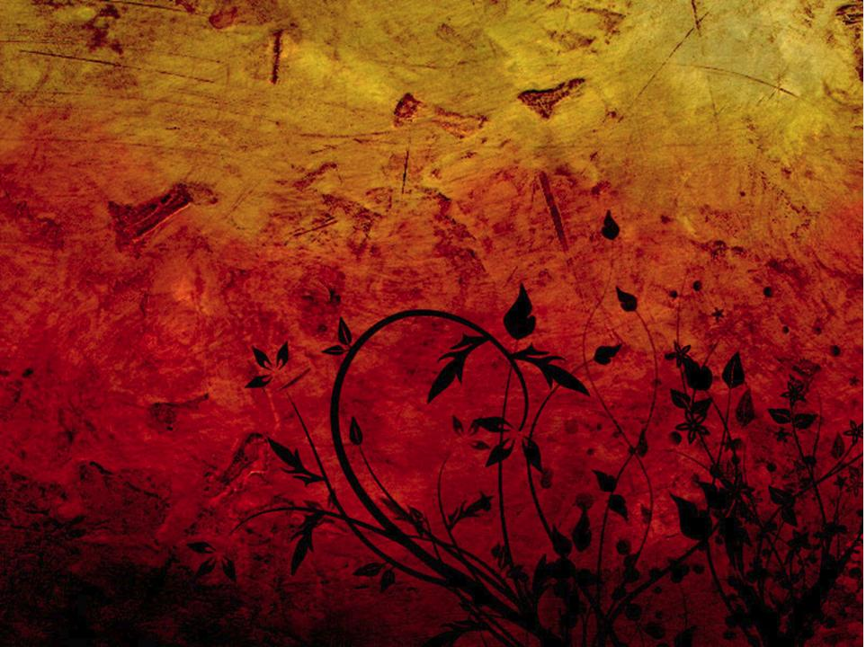
Great is the Lord,
He is worthy of praise.
Hosanna to the King!
Sing to the Lord,
let your voices be raised.
He is the King of glory!
至大的主,值得咱的謳咾.
和散那咱的王!
謳咾我主咱著大聲謳咾.
祂是榮光的君王!

Slide 44

Blessed is He, the King of kings,
who comes in the name of the Lord.
Lift up your heads, O royal gates,
be lifted up, ancient doors.
祂要賜福，萬王的王，
祂是佇主的名來的.
舉起你頭，榮光的門，
義的門著受舉起.

Slide 45

Sing “Hosanna, Hosanna to the King!”
Sing “Hosanna!”
He is the King of glory!
唱和散那，和散那咱的王。
唱和散那，
祂是榮光的君王.

Slide 46

Great is the Lord,
He is worthy of praise.
Hosanna to the King!
Sing to the Lord,
let your voices be raised.
He is the King of glory!
至大的主,值得咱的謳咾.
和散那咱的王!
謳咾我主咱著大聲謳咾.
祂是榮光的君王!(2X)

Slide 47
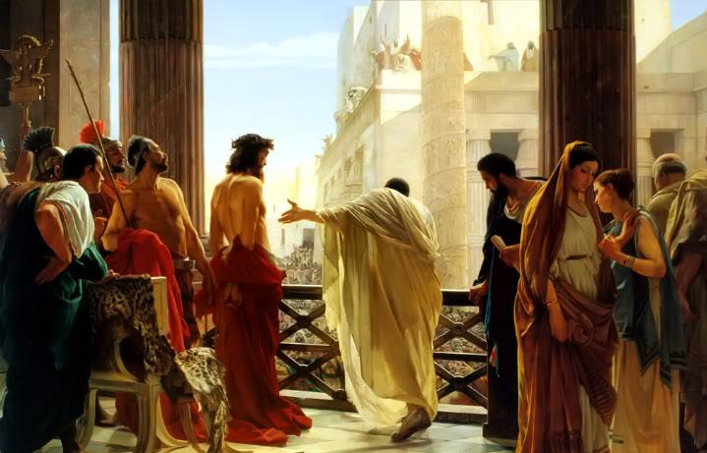
Pontius Pilate 彼拉多
My name is Pilate. As governor of Judea, the city of Jerusalem was in my jurisdiction.
我是彼拉多，做猶太地的總督，
管轄耶路撒冷。

Slide 48

I didn’t know much about this Jesus, but the stories about Him were wild and conflicting, to say the least. Some said He was God’s own Son. Others claimed He could raise the dead to life, make the blind see, and even walk on water!
對這位耶穌，我所知無真多，但有關祂的事卻很奇怪和紊亂。有人說祂是上帝的兒子，又有人說祂能使死人復活，使睛瞑看見，甚至能行在水面。

Slide 49

Still others said He was a threat to the people in my province and even to Rome. These religious Jewish leaders captured and brought Him to me seeking my permission to kill Him.
還有一些人說祂對我所管轄的人民，甚至羅馬，攏有威脅。
這些猶太人的頭捉祂，帶祂到我面前要我定祂死罪。

Slide 50
He didn’t seem all that different as
He stood before me.
He hardly answered my questions.
I had the power to release Him,
to save Him from the death sentence His accusers were seeking.
當祂站在我面前，我並不感覺祂與平常人有什麼兩樣。
祂不大願意回答我的審問，
我有權柄釋放祂，讓祂不受定死罪。

Slide 51
There was something disturbing about this whole scene! Though I knew little about Jesus, I certainly found nothing in the allegations, nothing in His actions or demeanor, nothing over which to send Him to a criminal’s death on a cross.
這一幕讓我心真攪擾!雖然我對耶穌所識很少，但我查不出這人作了甚麼惡事，也沒有查出他有甚麼該死的罪來釘祂十字架。

Slide 52
That’s what I told His accusers: “I find Him guilty of no crime.” Three times
I tried to release Him. But these people were relentless! I had no choice. I finally turned Him over to His accusers and let them have their way.
我給那些控訴者講:”我查不出他
有甚麼罪來。”我有三次想要釋放
祂，但那些人攏無憐憫之心，最後
我無通選擇將祂交回給他們，隨他
們的意思去做。

Slide 53
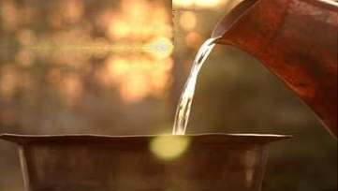
But I made it clear to them, I was washing my hands of this whole ordeal. I was innocent of this Man’s blood.
我清楚地向他們表明，又拿水在眾人面前洗手，說:”流這義人的血，罪無在我，你們去承當!”

Slide 54
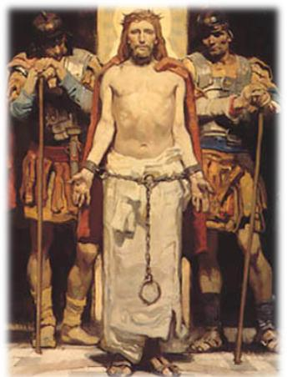
I’m still not exactly sure who this Jesus was, but as He was led away, it was like watching an innocent lamb being led
to slaughter.
我還是不確定這耶穌到底
是誰，只是祂被帶走的時
就親像看著一隻無辜的羊
羔將被人殺。

Slide 55

There was a heaviness surrounding Him at that moment – and me, for the matter. It was like He carried the weight of the entire world upon His shoulders.
那時有真沉重的氣氛包圍祂和我。看起來祂親像是將全世界的重擔攏背在自己的肩甲頭。

Slide 56
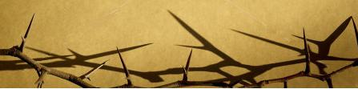
Surely He has borne our griefs.
Surely He has borne our sorrows.
He was wounded for us,
bruised and rejected for us.
The chastisement of our sin
was placed on Him.
確實祂擔咱苦悶，確實祂背咱的苦痛
祂為著咱受傷，祂為著咱受棄捨
咱一生的罪攏歸佇他身上

Slide 57
Surely He has borne our griefs.(2X)
Surely He has borne our sorrows.(2X)
He was chosen for us, alone, He stands there for us. The sins of the all the world were placed on Him.
確實祂擔咱苦悶，確實祂背咱的苦痛
確實祂爲著咱受選,
祂孤單佇咱身邊,
祂來擔當世間攏種總的罪過.

Slide 58
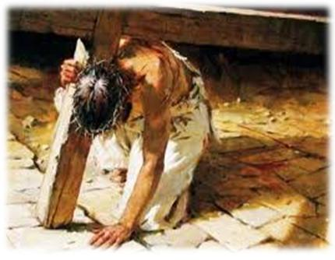
All we like sheep have gone astray, we've turned to our own way,
yet by His stripes we have been healed.
咱攏親像羊行迷路，行自己的偏路，祂受鞭打咱得醫好

Slide 59
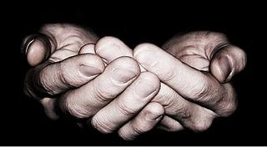
Messiah, holy Lamb of God, Redeemer full of love,
rejected Man of sorrows.
彌賽亞上帝聖羊羔,
贖回咱充滿疼,
受棄捨閣受苦難.

Slide 60
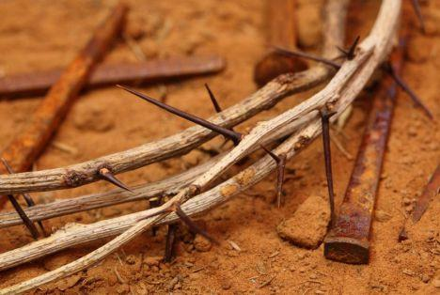
"Man of Sorrow," what a name for the Son of God, who came for ruined sinners to reclaims!
受苦的人，
祂的名是上帝的子,
祂來為要宣布罪的赦免!

Slide 61
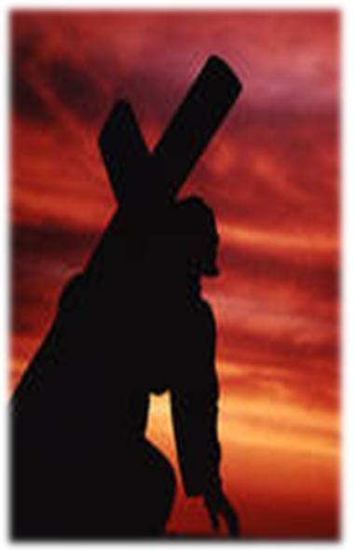
Hallelujah,
what a Savior!
Surely He has borne our griefs.
哈利路亞
拯救的主，
確實祂背咱苦痛

Slide 62
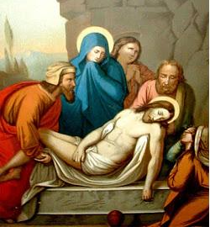
Joseph from the town of Arimathea
亞利馬太的約瑟
As a member of the Jewish high council,
I had been part of the discussions and decisions about what to
do with Jesus.
成做猶大公會的一員，
我也參與欲如何處置
耶穌的討論和決定。

Slide 63

My name is Joseph from the town of Arimathea. I had heard the stories and seen the people impacted by
this Man’s life.
我是亞利馬太的約瑟，我曾聽過，也親目看到多多人受這個人
生命的影響。

Slide 64
I didn’t know what to make of all of this, but I knew I couldn’t agree with my colleagues when they decided to sentence Jesus to death. To say the least, mine was a minority opinion.
我無清楚這些是如何造成，但是當我同事要求判耶穌死罪時，我知道我不同意他們的決定。 可惜我的意見只是少數而已!

Slide 65
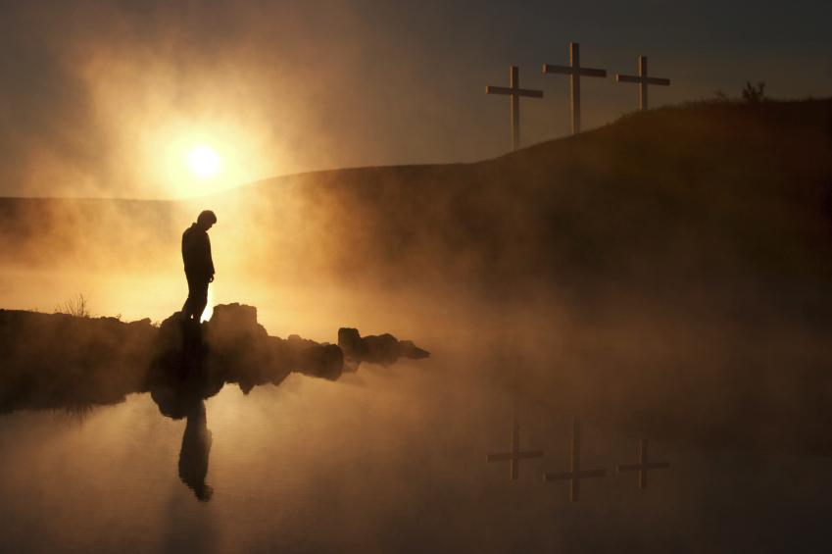
As I stood there on that hill, and observed the crucifixion of this so-called “criminal.”
I was struck by the irony of this whole event.
當我站在山頂，看著那人講的”罪犯”
被釘十字架，整個事件的轉變實在衝擊我。

Slide 66

Here was a Man who only a few days ago had been hailed as king when He entered Jerusalem with crowds surrounding and cheering Him. Where were those people now? They had all deserted Him and gone into hiding!
幾天前就是祂，在進入耶路撒冷時，
給群眾當作以色列王一樣圍著歡呼，
現在這些群眾走去那裡? 他們不是
棄撒他，就是躲起來。

Slide 67
Yet, as I observed His final hours, it was as if He were completing a mission He had been called to do. He offered some reassuring words to a faithful few who stood nearby, and even one of the criminals executed alongside of Him.
在我的觀察，祂生命的最後幾點鐘，祂親像是在完成一件使命，那是祂被呼召來做的。祂對幾個站在旁邊忠心的跟隨者提出再保証的話，甚至包括和祂同釘的罪犯。

Slide 68
Then just before He died, He shouted these words: “Father, into Your hands
I commit My spirit,” Chills ran down my spine!
就在斷氣以前，祂大聲喊著說:”
父啊!我將我的靈魂交在你手裡。”我的身軀一陣寒冷。

Slide 69
I went to Pilate asking for permission
to place the body of Jesus in a tomb
I owned. It was the least I could do before the Sabbath.
我去求彼拉多，欲領耶穌的身軀，
彼拉多允准，我就將耶穌的身軀放在石頭的墳墓裡，那裡沒有葬過人。這是在安息日的前一天我唯一能做的。

Slide 70
I was still tingled with guilt, I suppose, since I had been part of the group responsible for His death. Questions about this Man still haunt me.
我還是帶著欠愧，因為我也是那群造成祂被釘死的一份子。關於這個人的疑問總是攪擾我的心。

Slide 71
But in my heart of hearts, I cannot dismiss the words of one Roman office standing near the cross as Jesus died: “Truly, this was God’s Son!”
我不能忘記那羅馬的百夫長，
在看見耶穌喊，斷氣時所講的:”這人真是上帝的子兒!”

Slide 72
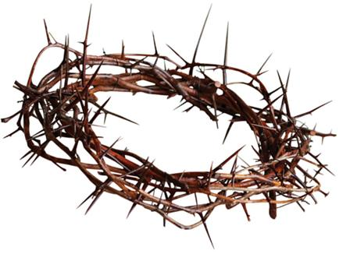
The soldiers gathered 'round this Man who was sentenced now to die.
" Hail to the King! they jerked at Him with shouts of "Crucify!"
兵丁圍累此人身邊,祂受宣佈著死刑,
猶太的王怹譏刺祂,喊釘祂十字架!

Slide 73
A crown of thorns placed on His head, they mocked His Deity.
They placed a cross upon His back as He walked to Calvary.
用刺仔冕旒給祂戴,諷刺祂神聖.
怹放十架在祂肩頭
當祂走向各各他.

Slide 74
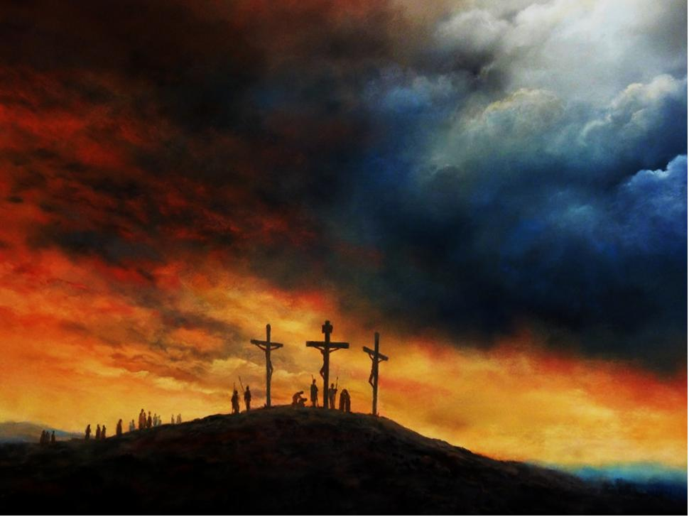
Truly, this was God‘s holy Son,
convicted and sentenced to be crucified.
確實這是上帝聖子,
受宣判受定罪受釘十字架.

Slide 75
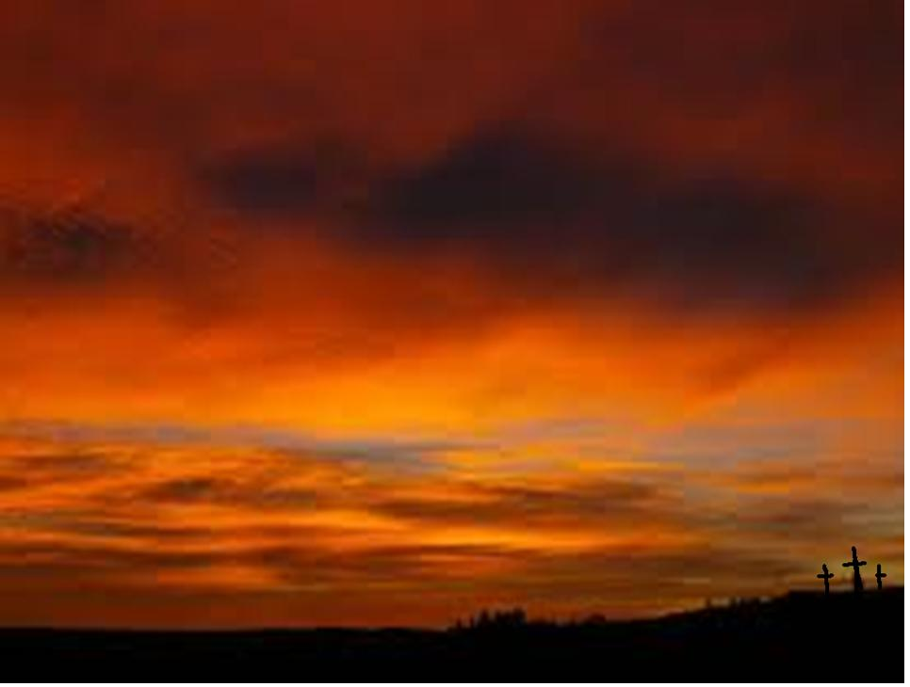
Truly, this was God’s chosen One, teacher, redeemer,
servant and friend.
Truly this was God‘s Son.
確實祂是上帝所選
教師,救贖主,奴僕,朋友.
祂是上帝聖子.

Slide 76
They nailed Him to a wooden cross
to die a criminal's death.
They scorned Him in His final hours
as He labored for each breath.
怹釘祂佇十字架頂,承擔死刑的罪.
怹鞭打祂到佇最後,苦刑祂每一口氣.

Slide 77
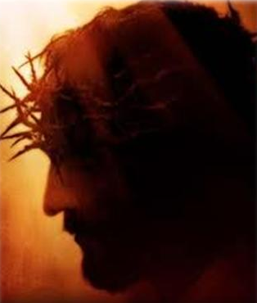
" My God, have you forsaken me?"
He cried in agony,
And then He breathed a final breath
and died upon that tree.
我的上帝放棄我嗎?
祂極痛苦嗷叫,
到佇最後的一口氣,
就死佇十字架.

Slide 78
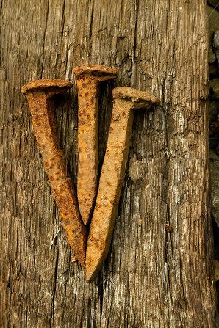
Truly this was God's holy Son, convicted and sentenced to be crucified.
Truly, this was God's chosen One,
teacher, redeemer, servant and friend.
Truly this was God's Son.
確實這是上帝聖子,
受宣判受定罪,受釘十字架.
確實祂是上帝所選,
教師,救贖主,奴僕,朋友.
祂是上帝聖子.

Slide 79
The wind grew chill upon that hill, the sky turned dark as night. God's plan revealed, salvation sealed by Christ, the crucified.
寒冷的風吹上山頂,天變暗像冥時.上帝救贖計劃顯明佇受釘主基督.

Slide 80
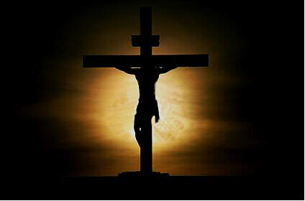
Truly this was God's holy Son,
convicted and now crucified.
Truly, this was God‘s chosen One,
teacher, redeemer, servant and friend.
Truly this was God’s Son. God's Son.
Truly , this was God's Son.
確實這是上帝聖子,
受宣判受定罪受釘十字架.
確實祂是上帝所選,
教師,救贖主,奴僕,朋友.
祂是上帝聖子,
祂是上帝聖子.

Slide 81
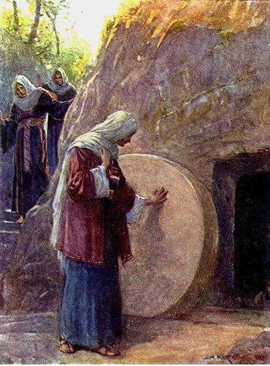
Mary Magdalene 抹大拉的馬利亞
It was early Sunday morning. It seemed like weeks since I had stood at the cross and watched Jesus die.
七日的頭一早起，對 我站在十字架下面， 看耶穌過身， 雖然只 有三天，卻親像過了 好幾個星期相款。

Slide 82

As I headed to the tomb to anoint the body of my Lord, my mind raced with memories.
Not only had Jesus freed me from my own demons, but I had watched Him deliver so many people from their own miseries.
在走向墳墓要去膏耶穌的身體的時，我的頭殼想起往事。不單單是耶穌從我身上趕出七個鬼，我也看著祂釋放多多人的不幸。

Slide 83
He had not only healed and cured others, but more importantly He had transformed Lives by His compelling message of love and grace. Now it seemed all of this had been for nothing!
祂不只醫治他們，更重要的是祂傳揚疼和恩典的信息，轉變他們的生命。但現在這一切親像是雲霧。

Slide 84
When I arrived at the tomb, I found that the stone had been rolled away!
I ran to Peter and John: “They have taken the Lord’s body out of the tomb, and I don’t know where they have put Him!”
當我到墳墓那裡，看見石頭已被挪開，就跑去見彼得和約翰，對他們說:”有人將主從墳墓裡挪出去，我不知道放在那裡。”

Slide 85
They ran to the tomb, confirming my words, then they returned to the others to tell them. As I stood outside the tomb weeping, a Man I thought to be the gardener approached me. “Why are you crying?” He asked.
他們一起跑去墳墓那裡，在確信我的話後，就轉去自己住的所在給同伴講。我自己站在墳墓外啼哭，一個我以為是顧園的走來問說:”婦人!為什麼哭?”

Slide 86
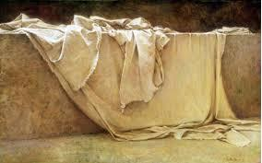
“Sir,” I responded, “if you have taken Jesus away, please tell me where you have placed Him.”
我就對他說:”先生!若是你將祂移走，請告訴我，你將祂放在那裡。”

Slide 87

“Mary!” He gently replied.
That was all He needed to say!
It was as if the scales from my eyes
had been instantly removed.
祂溫和的講:”馬利亞!”
這一句就夠了! 隨時我的眼睛親像有鱗片移走，
我所有的疑問或懷疑攏清楚了。

Slide 88
Any questions, any doubts that I had were gone! I knew this was Jesus,
the living Christ, standing before me!
The exhilaration in my spirit propelled me back to the disciples:
我知道祂就是耶穌，活活的基督，
就站在我面前。我真正歡喜，
緊緊走轉去給門徒講:

Slide 89
“He is alive!
Jesus is risen from the dead!
I have seen Him!
Praise be to God!
Jesus is alive!”
“祂，活了!耶穌從死裡復活了!
我看見祂了，讚美上帝!
耶穌真正復活!”

Slide 90
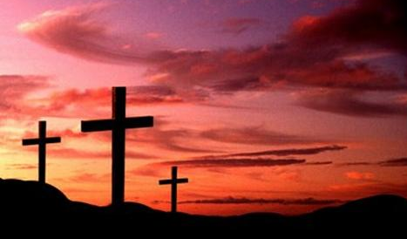
Worthy is the Lamb! Worthy is the Lamb that was slain to receive power,
wisdom and strength,
honor and glory and blessing.
高貴的羊羔，高貴的羊羔，
受㓤來承受權能智慧能力，
尊貴與榮光受祝福

Slide 91
Worthy is the Lamb!
Worthy is the Lamb on the thorn to be praised, honors, and glorified with power forevermore!
高貴的羊羔在寶座來受謳咾
尊貴與極榮光，有權力到永遠

Slide 92
Crown Him with many crowns,
The Lamb upon His throne;
Hark! How the heavenly anthem drowns
All music but its own。
羊羔坐在寶座,眾人奉獻王帽
聽天頂讚美聲音,嬴過眾人所吟

Slide 93
Awake, my soul and sing
Of Him Who died for thee,
And hail Him as thy match-less King
Through all eternity.
我心吟詩歡喜,感謝祂替咱死,
讚美稱呼至大君王,咱着永遠尊崇.

Slide 94
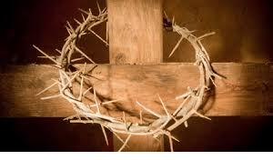
Crown Him the Lord of life!
Who triumphed o’er the grave,
Who rose victorious in the strife
For those He came to save.
讚美活命君王,較嬴死失墳墓,
祂有復活得着勝利,拯救萬民免死。

Slide 95
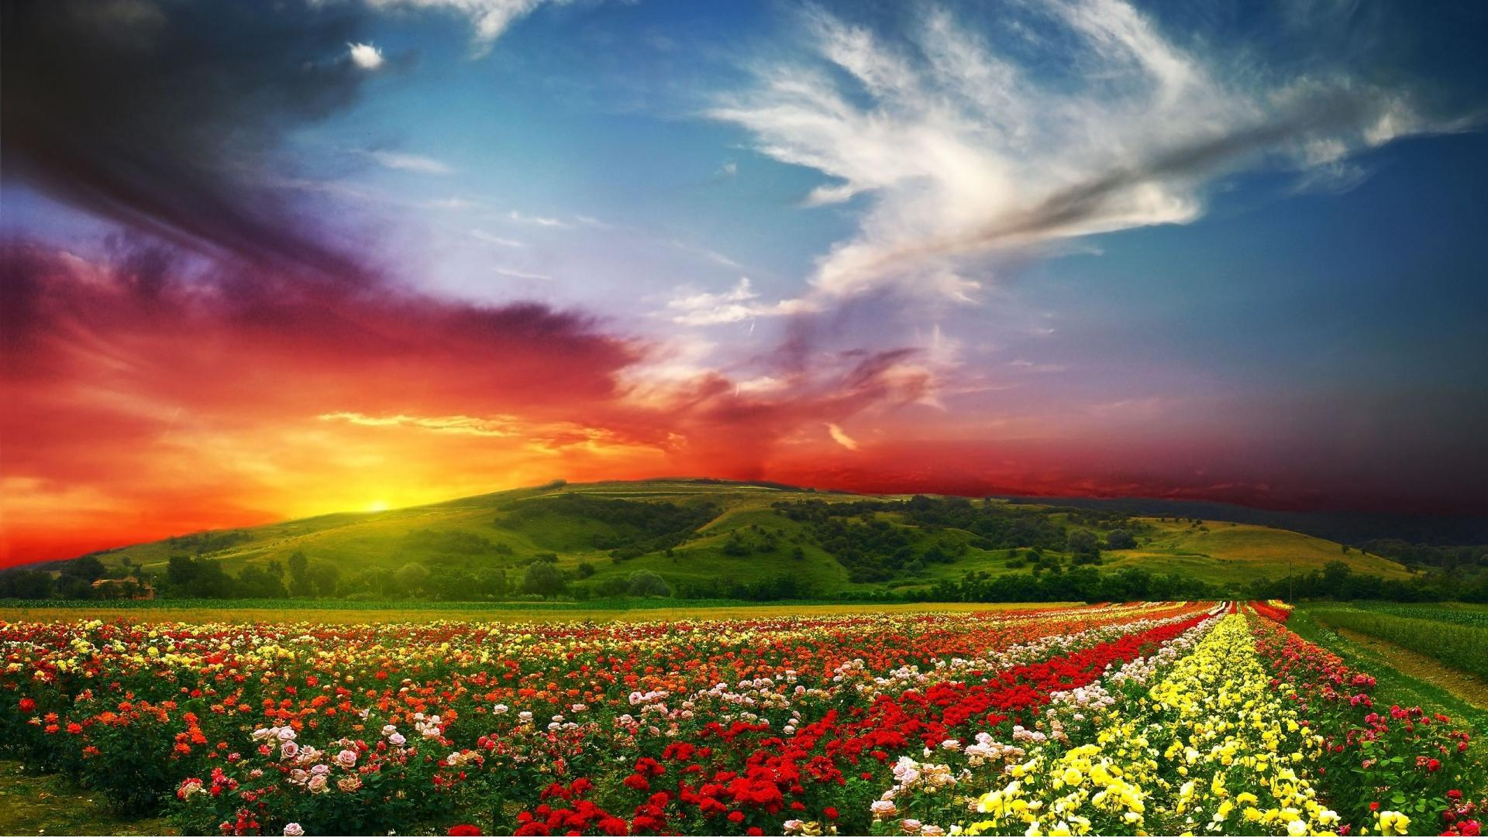
His glories now we sing,
Who died, and rose on high,
Who died eternal life to bring,
And lives that death may die.
今着吟詩稱讚,救主高升極高,
由主的死咱得永活,感謝讚美無息.

Slide 96
God with us! The Lord of Life in us!
Triumphant King who reign on high.
God is with us!
主同在！與活命主同在！
得勝的王管理萬有。上主同在！

Slide 97
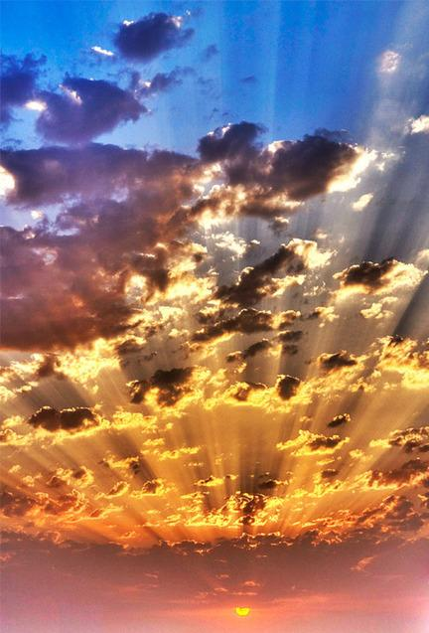
God with us! Conquered the grave for us!
Eternally our song shall be:
God is with us now and evermore! A men。
主同在！替咱得勝死亡！
永遠歌聲是咱所吟，
上主同在，從今到永遠！阿們

